Slide 1
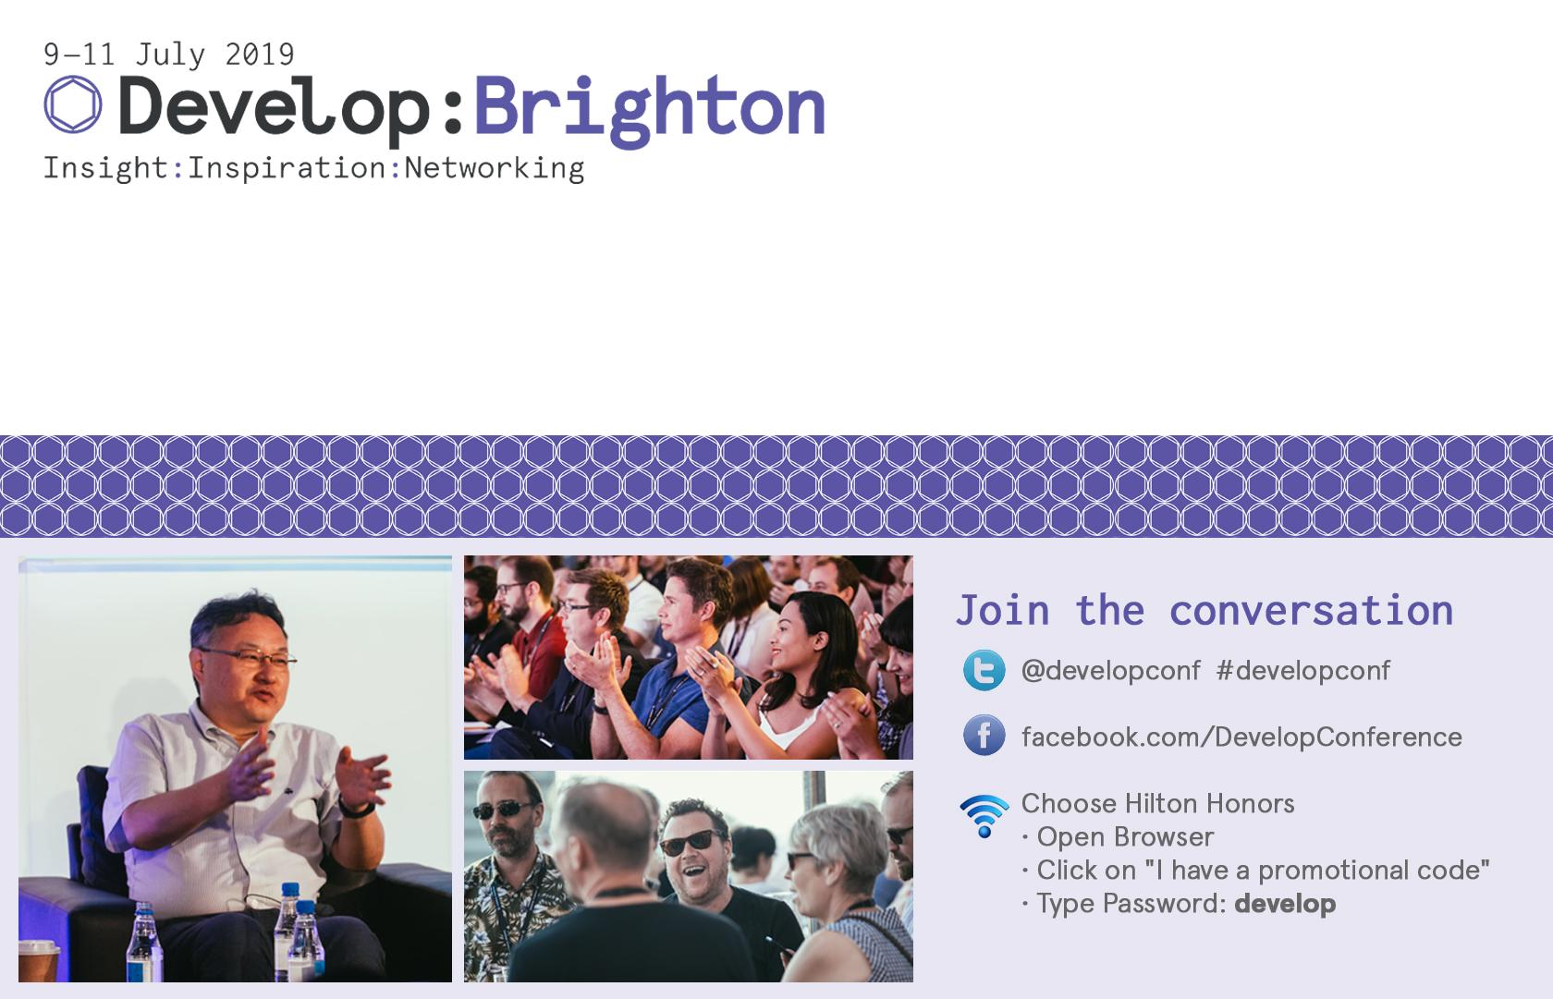
Thomas Buijtenweg - buijtenweg.t@buas.nl
Mata Haggis-Burridge - haggis.m@buas.nl
Riccardo Galdieri - r.galdieri@santannapisa.it
Unicorns and Dead Ducks
A Practical Workshop in Accelerating Game Design Concepting

Slide 2
Workshop Outline
Intro
The Problem
Ideation Cards
User Stories
Tutorial
Round 1 2 3
Recap
Bonus Round! (If we have time)
In about 1:45 minutes

Slide 3
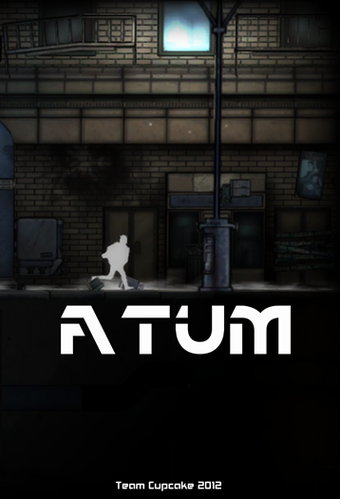

About me
Thomas Buijtenweg MSc
Game Designer
Researcher
Lecturer
Coordinator - Master Game Technology

Slide 4
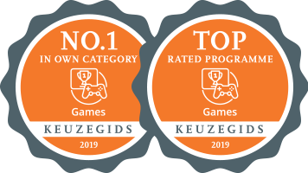
BUas-CMGT-IGAD
Breda University of Applied Sciences - Creative Media and Game Technologies

Slide 5
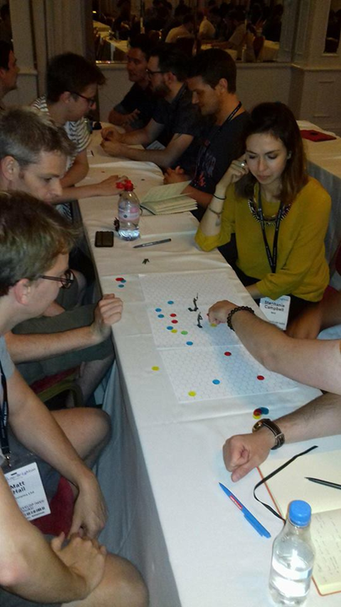
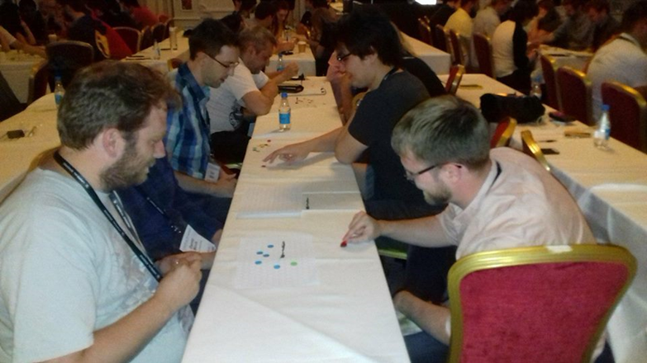
Last Time

Slide 6
Concept Problems
You just released your game and are planning your next project
Your team has a solid understanding of the systems of the previous game but making something new brings a bucket of possible challenges
What was successful in the previous game and how do we iterate this further?

Slide 7
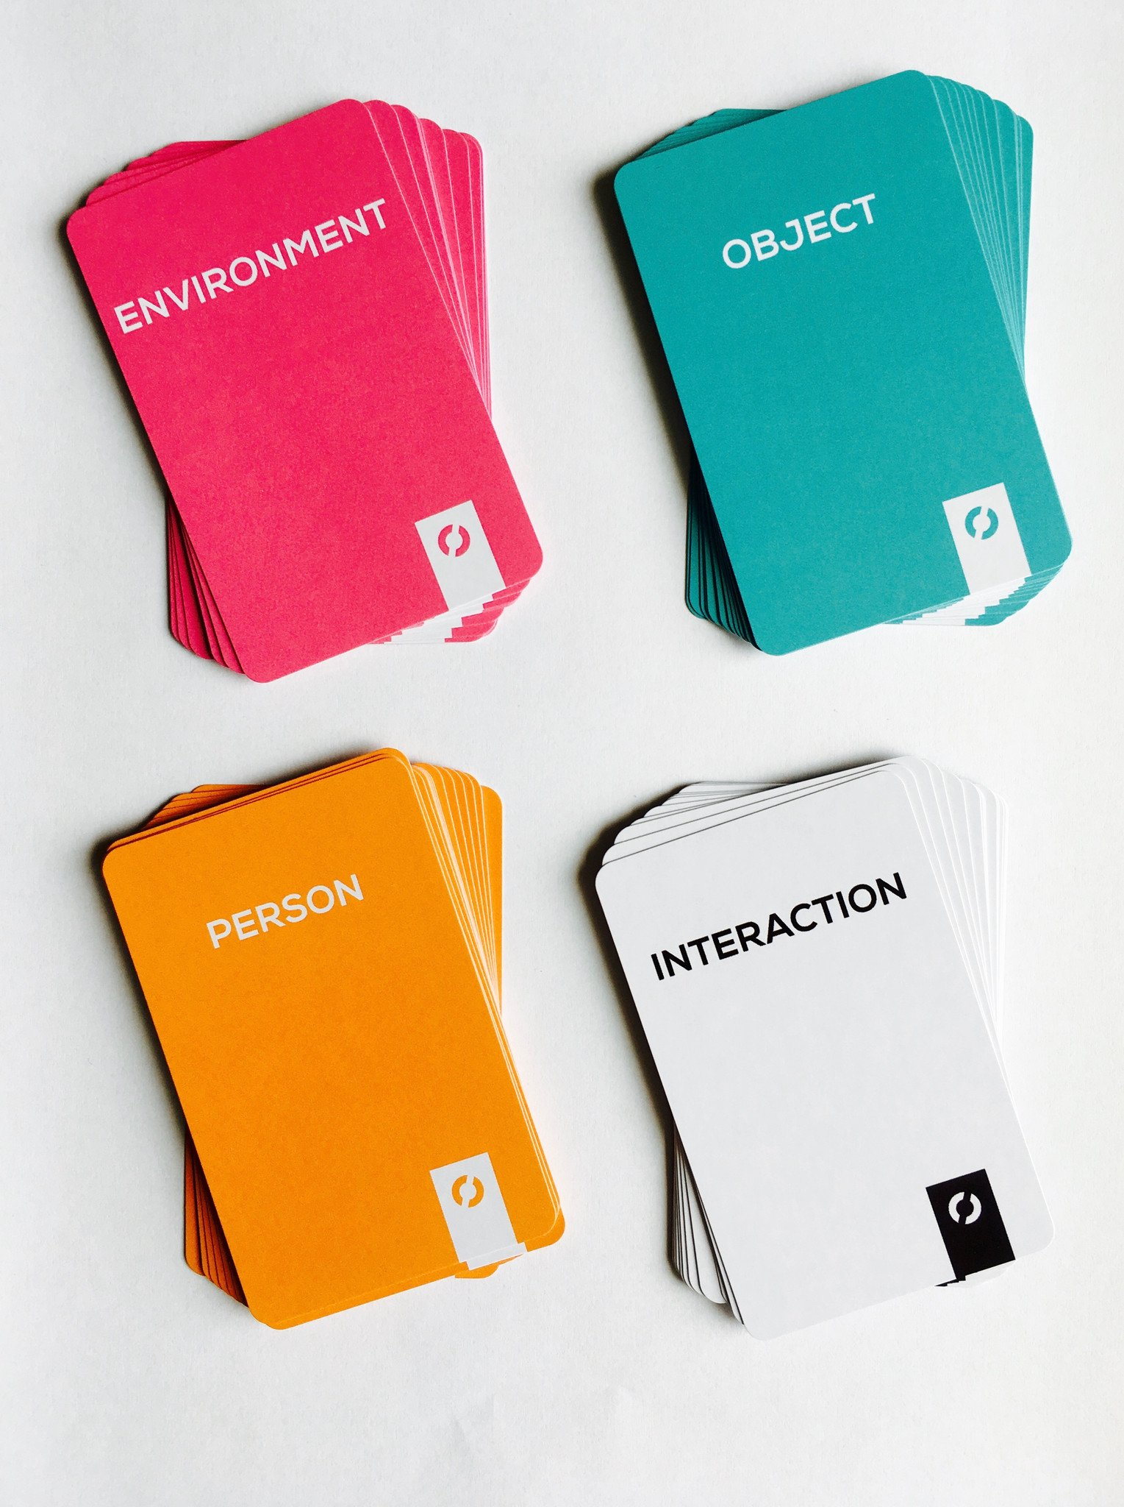
Ideation Cards - What are they?
Sometimes called Trigger Cards or Brainstorm Cards
Used to stimulate concept development and creative thinking
Many variations exist, with varying levels of usefulness

Slide 8
Ideation Cards - Useability
Basic approach is to prompt the reader to think about elements of a product by asking questions
Some decks are catered to specific fields of development allowing for a more focussed set of questions
Similar to writing a GDD

Slide 9
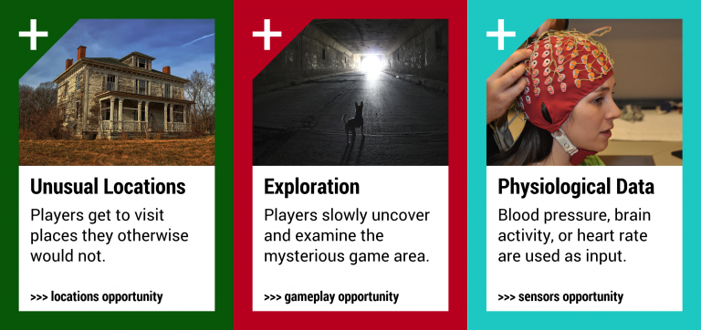
Ideation Cards - Useability
https://www.pervasiveplayground.com/mixed-reality-game-cards/

Slide 10
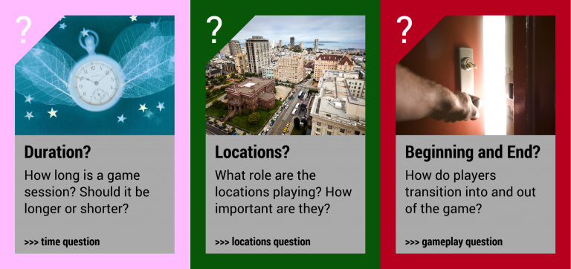
Ideation Cards - Useability
https://www.pervasiveplayground.com/mixed-reality-game-cards/

Slide 11
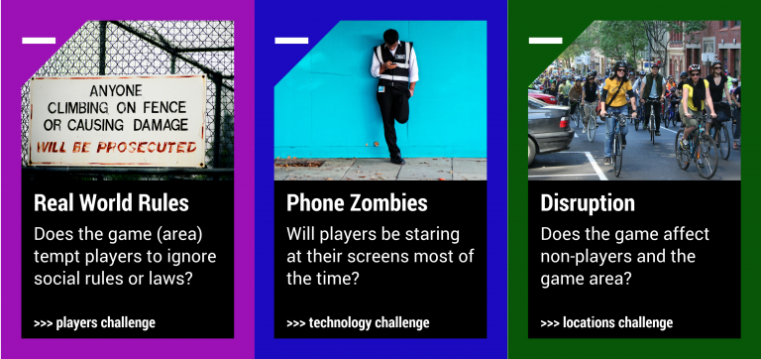
Ideation Cards - Useability
https://www.pervasiveplayground.com/mixed-reality-game-cards/

Slide 12
Ideation Cards - Strengths and Weaknesses
Can help novice designers create a basis to work from
Forces the developer to consider each card, limiting accidentally forgetting an important element (audio…)
Design is limited to the card deck
Not custom to your team or project

Slide 13
User Stories - What are they?
A user story is a very high-level definition of a requirement
Contains just enough information to estimate of the effort to implement it
Agile Scrum Method to map out stakeholder requirements
Used to populate kanban boards to divide tasks
As a Student I want to purchase a parking pass so that I can drive to school
As a (role) I want (something) so that (benefit)
http://www.agilemodeling.com/artifacts/userStory.htm

Slide 14
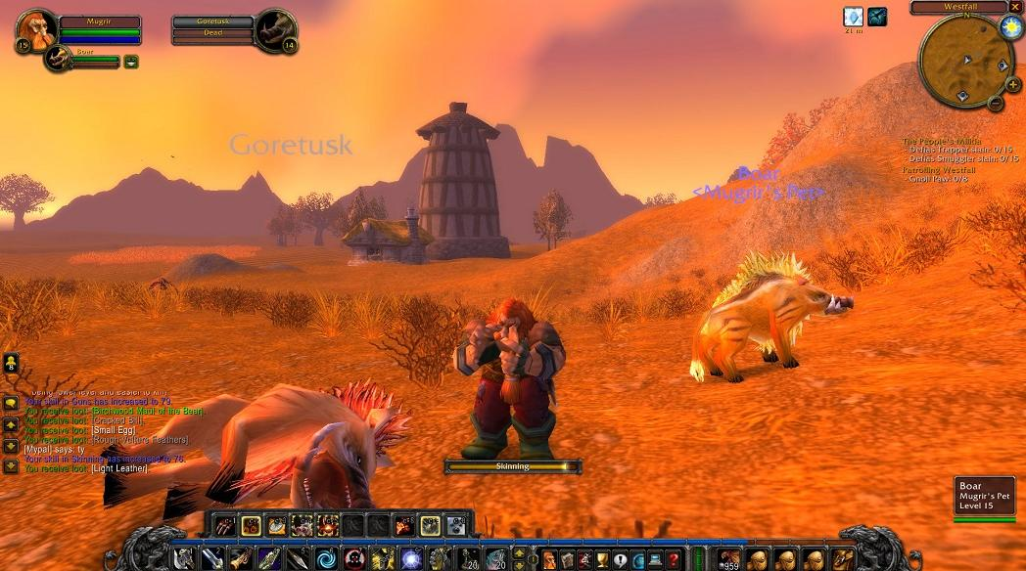
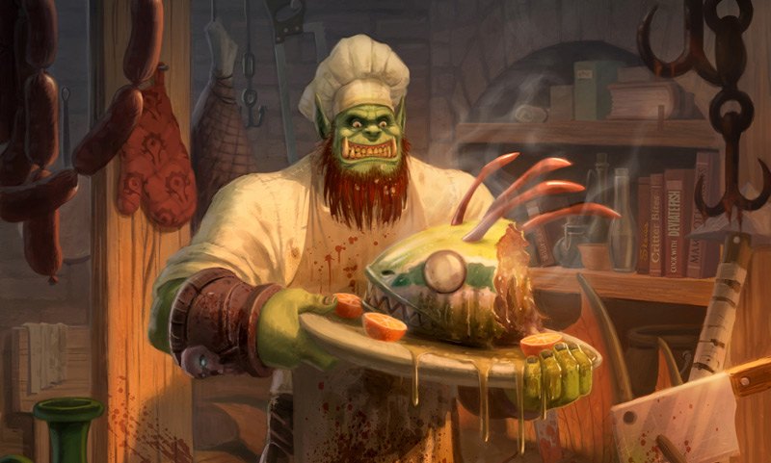
User Stories - Useability
In a game context:
As an Adventurer
I want to slay boars
so that I can collect meat
http://www.agilemodeling.com/artifacts/userStory.htm

Slide 15
Round 1 - Example
As a (role) I want (something) so that (benefit)
As a Footballer I want to sprint so that I can reach the ball faster
As a Driver I want to drift so that I can score points
As a Merchant I want to sell goods so that I can make money

Slide 16
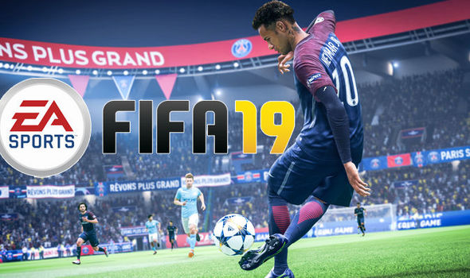
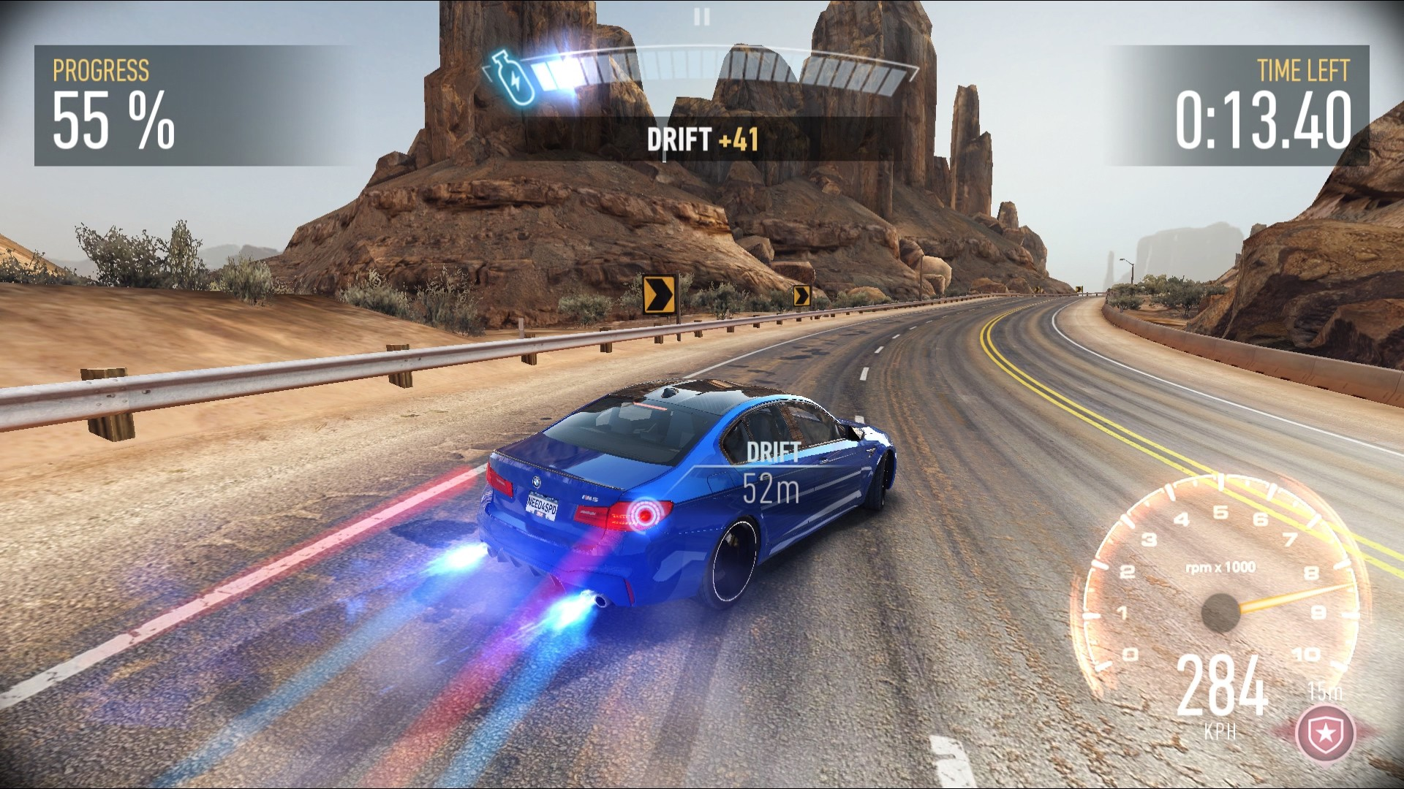
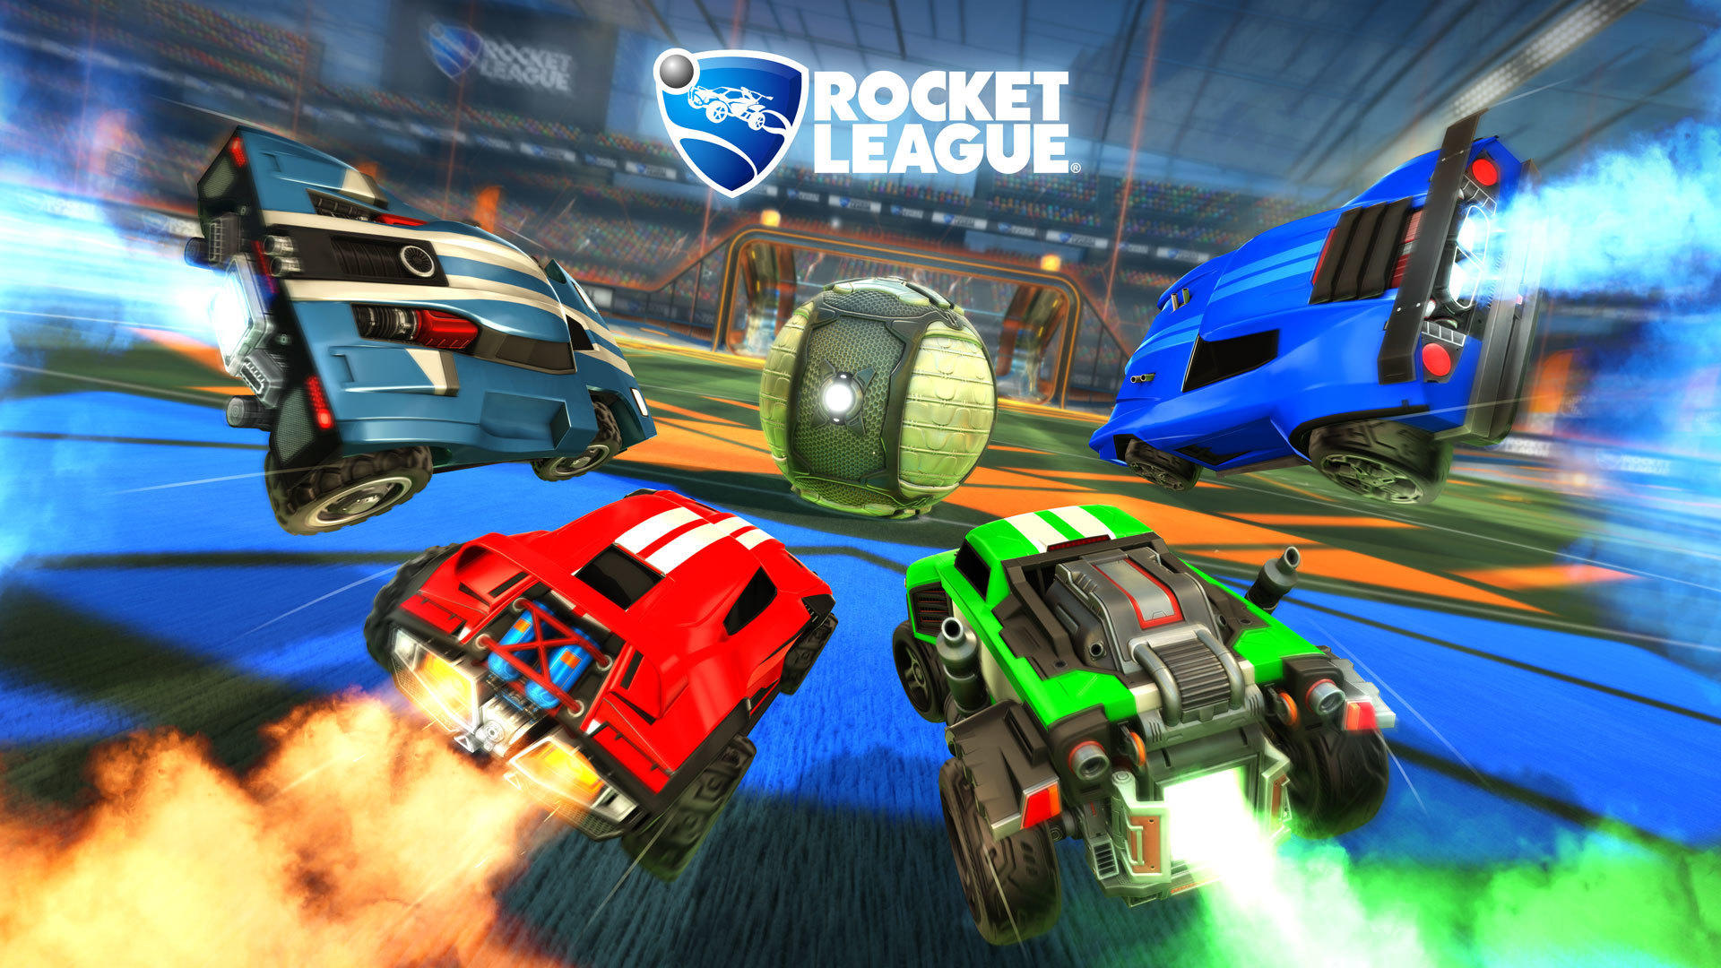
Round 1 - Example
As a Footballer I want to sprint so that I can reach the ball faster
As a Driver I want to drift so that I can score points
As a Merchant I want to sell goods so that I can make money
As a Driver
I want to drift
so that I can reach the ball faster

Slide 17
Round 1
Form groups of 3
For each group member write 2 user stories about the last game you worked on (If it’s NDA work, use another game)
  Try to write the most core element of that game as a user story
As a (role) I want (something) so that (benefit)

Slide 18
Round 2
Stack and shuffle the matching colours into 3 decks
As a group, draw and lay out 3 cards from each deck
As a group, make a new concept
  You can alter the cards you drew
  You can rearrange the cards as you like
  Create new cards if you want to
Take a picture of the current concept

Slide 19
Round 3
Pass on the remainder of the decks to the group on your left
Draw 2 more cards from each of the new decks you just received
As a group Improve your concept
  You can alter the cards you got
  You can rearrange the existing and new cards as you like
As a (role) I want (something) so that (benefit)

Slide 20
Recap
Ideation Cards can be useful early on
… but you can make your own to include past success
User stories help you think from the perspective of the player and actors in your game
… and allow you to scope out a project from the very start
We can help you run these ideation workshops in your team
As a Concept Developer I want to help gamedev
so that games become better

Slide 21
Round 4 - Bonus Round!
Merge with another group
Gather all the cards of each colour
Shuffle the decks
Draw and play
As a (role) I want (something) so that (benefit)

Slide 22
Thank You!
Unicorns and Dead Ducks
A Practical Workshop in Accelerating Game Design Concepting
Thank you for attending the workshop!
If you have any questions let us know
You can reach us @:
Thomas Buijtenweg - buijtenweg.t@buas.nl
Mata Haggis-Burridge - haggis.m@buas.nl @MataHaggis
Riccardo Galdieri - r.galdieri@santannapisa.it

