Slide 1


Getting started with Unity
Speaker: Riccardo Galdieri
17/04/2018

Slide 2

How to take this lecture
I’m not a professor, I won’t be judging your final works and I won’t tell Prof. Carrozzino anything we say. Therefore, feel free to:
  Interact, ask (even the dumbest) questions, mess around with Unity.
“Useful links” slide at the end of the presentation, if you want to dive
deeper into Unity development
These slides will be published (somewhere) online. No need to take
notes!
If you want to ask any further Unity-related question, you can
reach me at riccardo.galdieri@santannapisa.it
17/04/2018

Slide 3
A bit about me...
PhD student in Emerging Digital Technologies at Scuola Sant’Anna
Former Digital Humanities student:
  BSc in Digital Humanities (tutor: Felice Dell’Orletta)
  MSc in Digital Humanities (tutor: Marcello Carrozzino)
  Former King’s College London and National Taiwan Univerity student
Research interests: Human-Computer Interaction, interaction
metaphors in Immersive Virtual Environments, behavioral
long-term effects of VR exposure
17/04/2018

Slide 4
....and a bit about you
What’s your major?
Can you code? What languages do you know?
Do you usually play games?
The last game you played?
What platform do you usually play with?
17/04/2018

Slide 5

Part 1: what is a game engine?
17/04/2018

Slide 6
A long long time ago...
In the good old days, for every application programmers had to write a new engine from scratch. It was:
  Impractical
  Expensive
  Time consuming
Hardware was evolving too fast to re-use code. Each single application was tailored to make the most of the memory it had.
High level languages were still not common. Most of the code
(including ALL the GPU drivers) were written in Assembly
17/04/2018

Slide 7
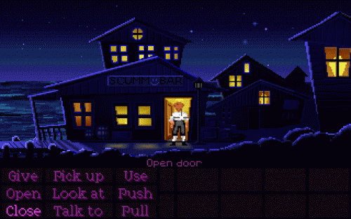
Script Creation Utility for Maniac Mansion (SCUMM)
Created in 1987 (Maniac Mansion)
Used by many companies to produce over 50 games:
  LucasArts (Indiana Jones,
  Zak McKracken, Full Throttle,
  Monkey Island)
  Sierra on-Line (Leisure Suit Larry,
  King’s Quest, Space Quest)
Mainly used for graphic adventures
17/04/2018

Slide 8
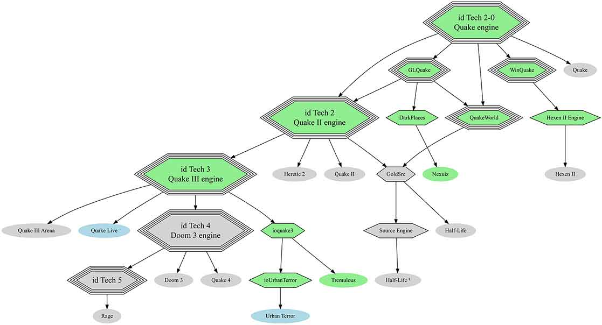
The first (un)real engine
17/04/2018

Slide 9
Modern game engines
Made by third party software houses
They are usually not genre-related, and can be adapted to different types of contents:
  Bigger market for the producers
  Easier to expand
They already implement almost all the modules that may be
needed in a game:
  Programmers only need to develop assets and game logic
Very wide range of licenses:
  Can be used by everyone, including hobbysts and universities!
17/04/2018

Slide 10










Modern game engines
17/04/2018

Slide 11
Part 2: Why Unity?
17/04/2018

Slide 12
What is Unity?
Unity is a multi-genre Game Engine. Not surprisingly, it was developed to create videogames!
Founded in 2005 in Denmark, it now counts over 1500 employees all over the world, a huge venue in San Francisco, and its current value is
estimated in 1.5 BILLION dollars.
Free for personal use if your company earns less than $100k in
annual gross revenues.
Recentely released its source code (sort of)
But... What can I do with it?
17/04/2018

Slide 13
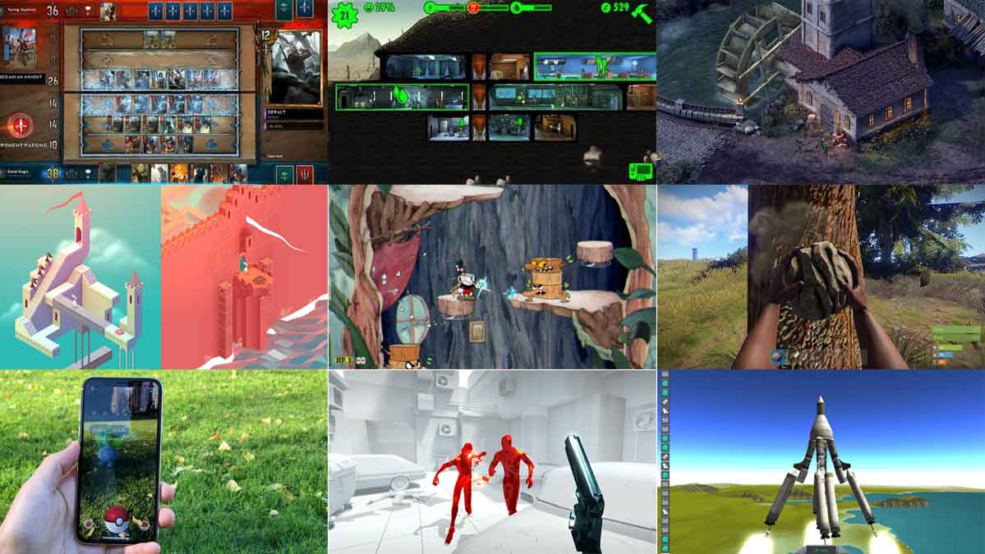
17/04/2018

Slide 14

Why Unity
Unity used to be popular between Indie developers because it has:
  A huge community support (forum/Answers) and countless tutorials
  on the internet
  State of the art documentation, complete with examples and source
  code
  Simple user-friendly interface
It costs you nothing unless you’re making money!
Can deploy a project to over 25 different platforms:
17/04/2018

Slide 15
Why Unity
Can be customized and expanded in many different ways (Preprocessing instructions, extensible UI, external DLL support)
Unity is artists-friendly: artists do not need any technical skill to import, tweak and place their work
It is also programmer friendly: no explicit pointers, references are
handled behind the scenes:
  It’s extremely hard to make Unity crash!
Unity scripting is based on C#.
  It used to support Boo and JS, that’s why it’s still called
  scripting
17/04/2018

Slide 16
Why Unity (A little bit more techinical)
It’s an «Event Based» program (VS procedural programs). Every action is triggered as response to an event
Custom rendering pipeline: rendering pipelines can be customized to
better adapt to different platforms
Lightweight releases
Component-based extensible behaviours
Multi-scene editing
17/04/2018

Slide 17
Part 3: Tech Demo!
17/04/2018

Slide 18
Useful links
Official Unity tutorials repository – Covers every possible topic, from basic components to scripting.
Unity Forum and Unity Answers – Superb communities, if you have any question this is the best place to go
Scripting API – Sooner or later you’ll have to start coding.
Udemy – Paid course, but definitely worth it.
YouTube, Google, and Facebook groups – Do I really have to tell
you how to use these?
17/04/2018

Slide 19

«In case I don’t see ya,
good afternoon, good evening,
and good night»
Questions?
17/04/2018

