Slide 1


Getting started with
Virtual Environments
Speaker: Riccardo Galdieri

Slide 2

How to take this lecture
I’m not a professor, and I won’t tell Prof. Carrozzino anything we say. Therefore, feel free to:
  Interact, ask (even the dumbest) questions, mess around
  Record this lecture for personal use (But DO NOT share it)
“Useful links” slide at the end of the presentation, if you want to dive
deeper into Game Development
These slides will be published (somewhere) online. No need to take
notes!
If you want to ask any further question, you can reach me at riccardo.galdieri@santannapisa.it / riccardo.galdieri@gmail.com

Slide 3
A bit about me...
PhD candidate in Emerging Digital Technologies at Scuola Sant’Anna
Visiting staff at the Breda University of Applied Sciences (Breda, NL)
Former Digital Humanities student:
  BSc in Digital Humanities
  MSc in Digital Humanities
  Former King’s College London and National Taiwan University student
Research interests:
  Players’ subconscious behaviours in new environments
  Procedural ideas generation (ugs.guraas.com)
  Weighting environmental factors (UI, Narrative, interaction schemes) on UX
  Impact of real-life events on gaming

Slide 4
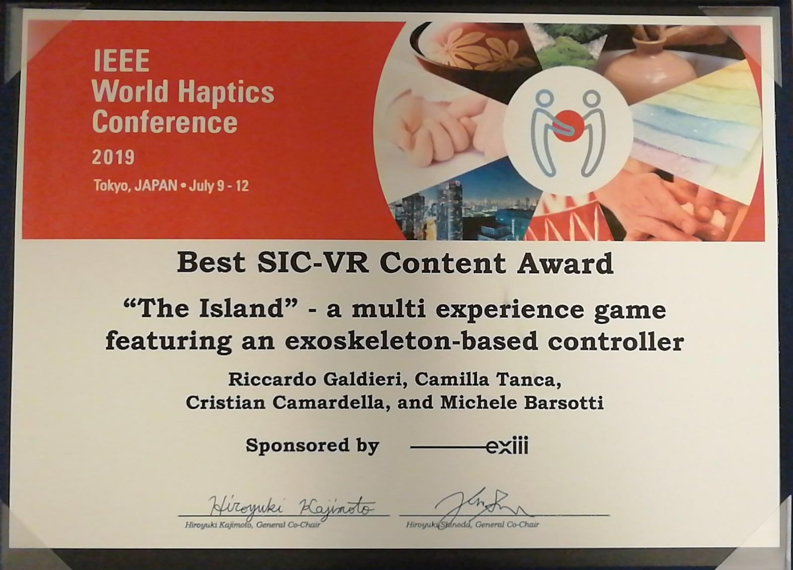
A bit about me...
VR «expert» (or whatever that means)
If you want to work with VR make sure to stick around after your exam!

Slide 5
....and a bit about you
What’s your major?
Can you code? What languages do you know?
Do you usually play games?
What’s the last game you played?
What platform do you usually play with?

Slide 6

On today’s menu
What is a Game Engine, and why you should use one
  A bit of history (for nerds)
Design your own gam… ehm, project
  What questions you should ask before even starting
Applications’ design pitfalls
Useful links and resources at the end of the slides
BONUS: let’s discuss the projects!

Slide 7
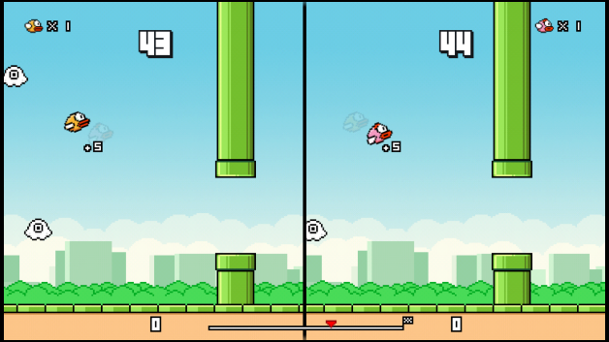
Part 1: what is a game engine?
Your project

Slide 8
A long long time ago...
In the good old days, for every application programmers had to write a new engine from scratch. It was:
  Impractical
  Expensive
  Time consuming
Hardware was evolving too fast to re-use code. Each single application was tailored to make the most of the memory it had.
High level languages were still not common. Most of the code
(including ALL the GPU drivers) were written in Assembly

Slide 9

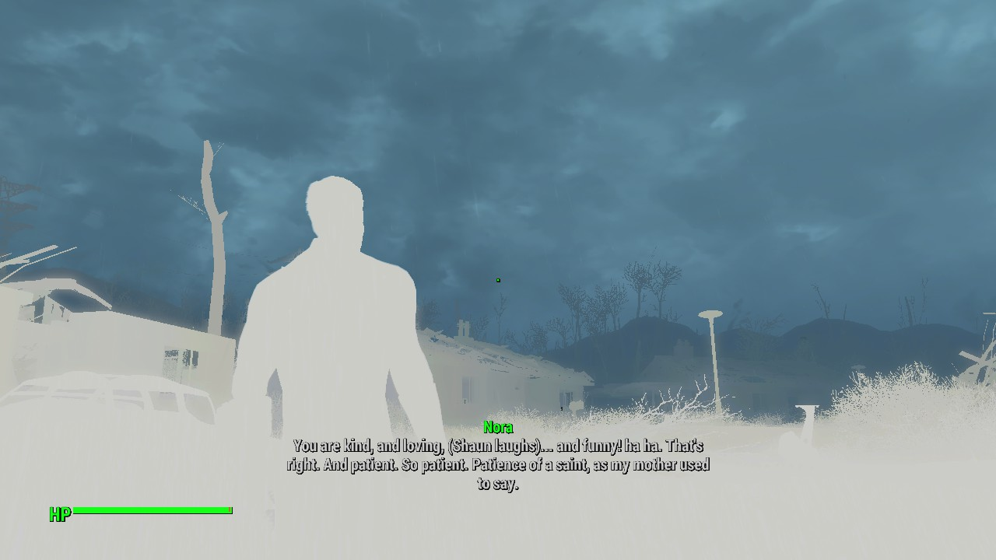
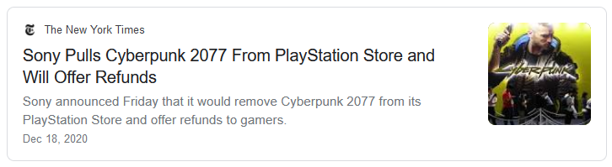
What happens with your own engine

Slide 10
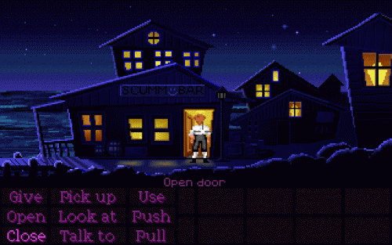
Script Creation Utility for Maniac Mansion (SCUMM)
Created in 1987 (Maniac Mansion)
Used by many companies to produce over 50 games:
  LucasArts (Indiana Jones,
  Zak McKracken, Full Throttle,
  Monkey Island)
  Sierra on-Line (Leisure Suit Larry,
  King’s Quest, Space Quest)
Mainly used for graphic adventures!

Slide 11
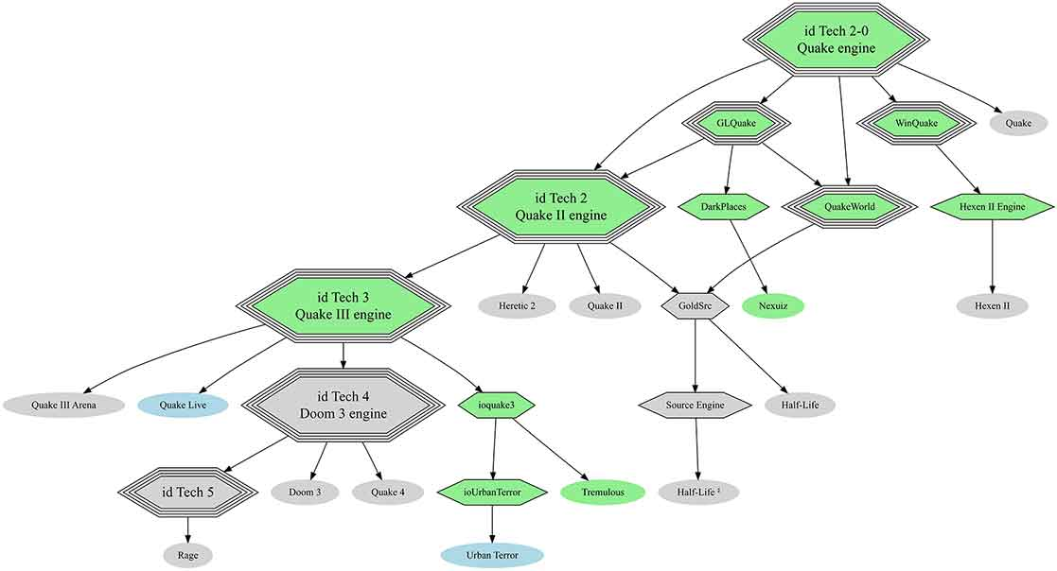
The first (un)real engine

Slide 12
Modern game engines
Made by third party software houses
  They make the engines, not the games
They are usually not genre-related, and can be adapted to different types of contents:
  Bigger market for the producers
  Can be used to satisfy more artistic views
They already implement many modules that may be needed in a game:
  Programmers only need to develop assets and game logic
For all pockets:
  Can be used by everyone, including hobbysts and universities!

Slide 13
Pros of using 3rd party enignes
They have communities that can help you!
More people => more testers => easier to spot bugs!
Reduced costs for the engine development
  Balancing between the costs of development and the cutout they take is one I wish you to have one day!
Are multi-platform
They allow you to focus on your own design only!
They are artists-friendly!

Slide 14










Modern game engines

Slide 15
Part 2: Application design

Slide 16
Application design
We generalized by saying that you need to feed an engine with your project, but assets aren’t everything
There are some fundamental questions that need to be answered before even opening your game engine
Your project

Slide 17
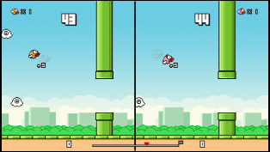
Application design
*your project
Who & Where
What
Audience & Environment
Architecture
Design
Deadlines
Code
When
Assets
Tools & Skills
How
Motivations
Why

Slide 18
X. When
“Nine women can’t make a baby in a month”

Slide 19
Managing time in projects
As much as we would love to, we don’t have infinite time. It is therefore important to manage the time we have in the best possible way.
“Work expands so as to fill the time available for its completion” (Parkinson’s
Law)
It is your responsibility to estimate the time needed to complete a task/project
  As much as we want you to make nice projects, please don’t take two years to
  develop your application (based on a true story)
Having too much time is as dangerous as having no time:
  Too much time leads to procrastination
  Not enough time leads to burnouts

Slide 20
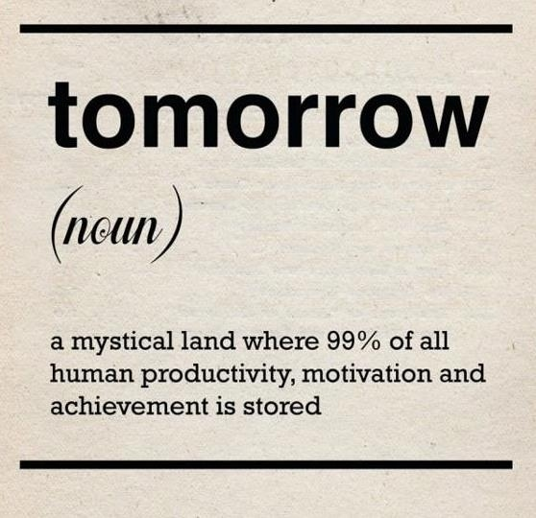
Deadlines
The bigger the project, the less accurate deadlines become:
  With an average error of 50% (not so unlikely), 6 days become 9 days, 6 months become
  9 months.
Different factors influence how you calculate your deadlines:
  How much you know about the software you will use
  How experimental is the project?
  Number of people involved in it
A wise task schedule can improve your productivity:
  Use an issue tracker to keep a record of your movements (Trello, JIRA, Mantis)
  Learn how to control your habits
    “The power of Habit” by Charles Duhigg – ISBN 9781400069286
Use the pomodoro technique!

Slide 21
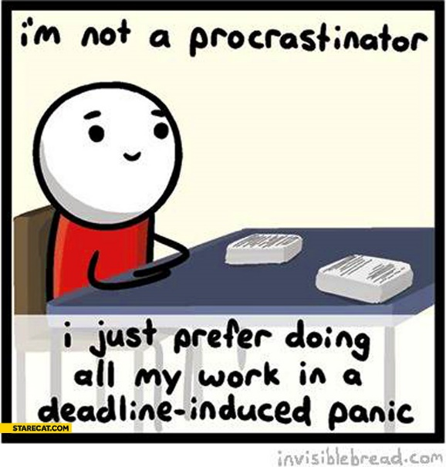
In one sentence….
Make sure to design your project for the time you have, not the other way around.

Slide 22
X. What
“Is a bug or a feature?”
“Yes”

Slide 23
Getting practical
At some point, you have to transform all your design into actual game
mechanics
What and How are strictly related
  What should be the skeleton of your application:
    Software structure
    Gameplay rules
    UI design
    Concept art
    Interaction design
  How is the practical implementation of those concepts:
    Code
    External data
    Sprites
    3D models

Slide 24
Planning phase
Once you have built a prototype and tested your drafts, start planning your application accordingly
If you have a team of people, it is important to be all on the same page. Professional teams use the so called “Game Design Document”
  Old but still nice to read: The Anatomy of a Design Document
  If the project is small, or the team is, a GDD is an overshoot
Set up a one, clear and well defined goal for your application: What are
you trying to achieve?
Paper drafts can turn out to be extremely useful!

Slide 25
Gameplay planning
As we already established, every virtual application has a purpose. But
translating that purpose into actual gameplay is a different thing
At this point you already have a goal and a planned interaction. Transform this concepts into game situations:
  What do you need in order to achieve your goal? AI? NavMeshes? Special controllers?
  How do you integrate these things in your environment?
  What’s your architecture structure going to be like?
Make sure that YOUR learning curve is balanced with the game difficulty

Slide 26
Gameplay planning
Lately a lot of people have been asking around how to build an MMORPG.
Game Designer Raph Kosher has published a list of what is needed to create an MMO:
  LINK

Slide 27
Software planning
If you start to write your application straightaway without planning it in
advance, you will fail*
Software design is a complex, yet beautiful, discipline. Do not reinvent the
wheel and study it:
  Design Patterns: Elements of Reusable Object-Oriented Software – ISBN 0201633612
  Familiarize with concepts like Abstraction, Modularity, Refactoring, Information hiding
Version control can save your life. Set up one before you even start
prototyping
Make sure to share coding standards with the other programmers
* Unless you are prototyping

Slide 28
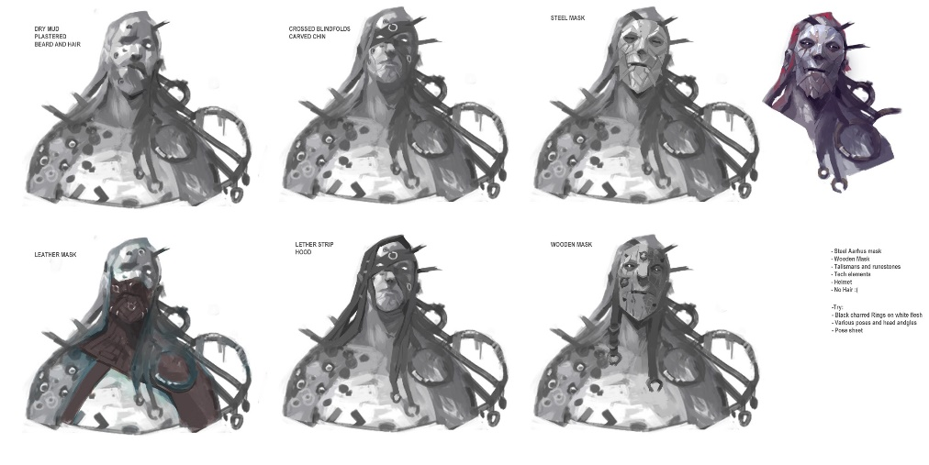
Graphics planning
While code can be explained, graphics can’t unless it’s drawn
Do not underestimate the importance of concept art. Concept artists are responsible to give your application its final look
Doing concept art is the most frustrating job in the entire process. 100% of what you do is judged and 95% of it is discarded
  Basically someone else will discard all of your wor

Slide 29
Graphics planning
Let’s make a little experiment:
  Think about a tall, male, muscled, bearded character, with tattoos

Slide 30
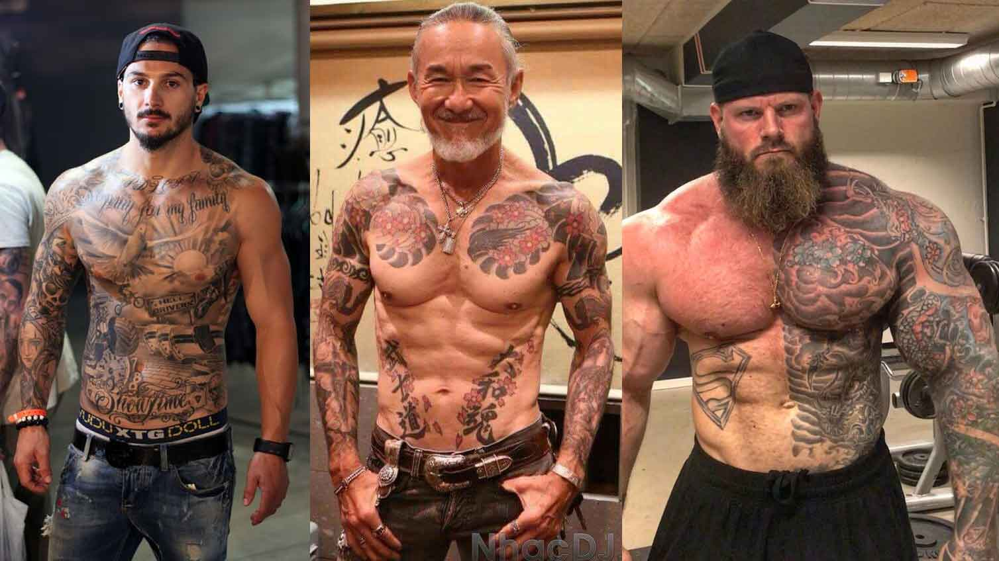
Graphics planning

Slide 31
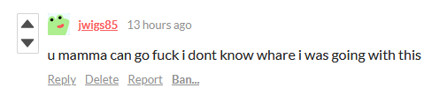
Drafts
If something works, you can see it from the beginning
  A cute character, a main gameplay feature, a particular dynamic
Always refactor your code, it will serve you well in the long term period
Start showing your project around. People can be a great vector of distribution, and sometimes they can even help you develop it further
  If your product is too good when you first show it, you’ve waited for too long
Get good feedbacks as soon as possible
  Unless they’re in the same business, friends will be too nice. Weight accordingly
  Many people online want to be mean just because they can hide behind
  the screen

Slide 32
In one sentence….
Drafts are the foundation of every project. First you design what you want, then you think about how to make it

Slide 33
X. How
“If you know the enemy and know yourself, you will not fear the result of a hundred battles”

Slide 34
Know your tools
It is fundamental to know the tools you are using, and how they can save
you a lot of work
  This should be trivial, but you’d be surprised…….
Keep yourself up to date, not your tools!
  Follow the latest development of your tool of choice, but please, PLEASE, do not update
  your version during the final phase. I repeat. DO. NOT. UPDATE.
It is your responsibility to make sure that the software used by all the compartments can exchange files
Let’s see some of these tools…

Slide 35









Game Engines
Unless you are writing your own structure, you will likely end up using a
game engine
Choosing one is extremely difficult, but the choice matters only as long as you know why you are choosing one over another

Slide 36
Some suggestions
Asking if you should choose Unity or Unreal is forbidden by the Geneva convention
Look at the main feature of your application, and see how it the engine could help you implement it
Make sure to know the language your game engine is using
Check for fast asset reloading and assets formats
Communities can make the difference between one day or three weeks to develop a feature

Slide 37
Graphics
Unless you are lucky, graphics will be a struggle more than anything else
Graphic designer do not have an active role in research, and unless you are planning on earning any money with your application, you may not be able to hire one
More than beautiful, graphics must always be coherent. Be careful with:
  Style – all assets should look like they were created by the same hand
  Definition – assets with a lower/higher density really stand out
The younger your audience is, the harder the comparison with the industry standard will be
  People are ignorant about how to make virtual applications, but this doesn’t stop them from judging your product

Slide 38






Graphics software
Unlike game engines, you are not forced to stick to one software only
  It is common to have certain features on one and not the other
Make sure to be able to import your assets into your game engine the way you need to
  Animations and materials are the usual pains, check them ASAP
The number of polygons is not as important as it used to be. The number of batches (Draw calls) is

Slide 39
In one sentence….
If you know your tools and know your project, design is just transforming your ideas in something concrete

Slide 40
X. Why
From “This is so cool I want to do it” to “I’m telling you to, that’s why”

Slide 41
Project incipit
There are many reasons for you to be involved in the creation of a virtual
environment:
  School projects
  Personal project
  Enterprise work
It is important to adapt your work based on some basic questions:
  Am I aiming for a shippable project?
  Is this a prototype of a new concept?
  Is there a game design document I must follow?
  How satisfying is this project going to be?
  Am I learning or just applying my knowledge?
  Am I involved in the design? Is it my idea?
  Do I choose the technology?

Slide 42
Project incipit
SCHOOL PROJECT | CASE | ENTERPRISE WORK
YES | Am I involved in the design? | NOT VERY OFTEN
YES | Is it my idea? | NO
NO | Am I aiming for a shippable project? | YES
YES | Do I choose the technology? | NO
NO (unless….. Nah, no) | Is there a game design document I must follow? | YES
LEARNING | Am I learning or just applying my knowledge? | APPLYING
VERY | How satisfying is this project going to be? | IT DEPENDS

Slide 43
Motivations as part of design
Be conscious of your goal. I.E.:
  If you are prototyping, don’t think about code structure, do as fast as possible
Weight your project according to your motivation:
  Intrinsic motivation will serve you well on a longer period of time. If something excites
  you and you don’t feel the weight of doing it, you can plan for a longer period of time.
  Extrinsic motivation is extremely powerful on the short period of time, but you can
  easily lose it over time. Great for prototyping, less on the longer period.
Keep the number of features as low as possible. Each product has only
ONE major feature, everything else is just contour.
  “WHOA, have you seen fallout 4? Best customization system ever! They also
  have great UI and superb colors!” – no one ever

Slide 44
In one sentence….
Always keep in mind why you are working on your project, and design in accordingly.

Slide 45
X. Who & Where
Programming today is a race between software engineers striving to build bigger and better idiot-proof programs, and the Universe trying to produce bigger and better idiots. So far, the Universe is winning.

Slide 46
Know your audience…
In order to be successful, it is CRUCIAL to know who your audience will be,
and where your application will be used
As designers, you are responsible for everything that happens around the users. Nothing should happen unless you designed it to
Do not build upon stereotypes or “common knowledge”, but collect data beforehand (if possible)
Study how to reach your target. It is pointless to develop any real application if you are not going to reach your audience

Slide 47
…And know your environment
Every virtual application needs a device to be played on. It is important to
design your application keeping in mind what the specs of that device are
If you can’t test your application on every single device, you’re playing the Russian roulette
  Read: keep the number of platforms low!
Different people use the same device in different ways
  Study how your audience engage with the given device
  Design your application to adapt their use of such devices
  Test your application with a sample of your audience
  Repeat

Slide 48
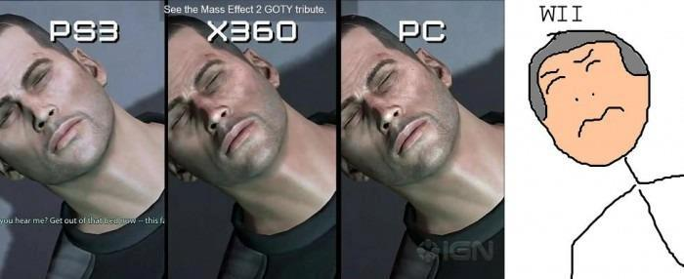
…And know your environment
It is not the environment that tells you how to make your game, it must be
you the one that adapts its own game to the environment

Slide 49
Data is king
A short list of features that might come in hand while trying to
identify your audience:
  Age
  Gender
  Native language
  Cultural background
  Social background
  Degree of education
  Experience with the target subject
  Familiarity with the designed interaction tools
  Interest in what you are proposing
Let’s try to make an example all together

Slide 50
Audience needs – user experience
As designer, you have control over your audience’s feelings.
There are many things that you can tweak to provoke the feelings you want in a given moment:
  Colours palettes
  Sounds and music
  Choices
  Dialogues
  Customization
  Competition
It is always worth to ask yourself if you could gamify your experience
  “Father and son” made by the Mann museum is the best example of this

Slide 51
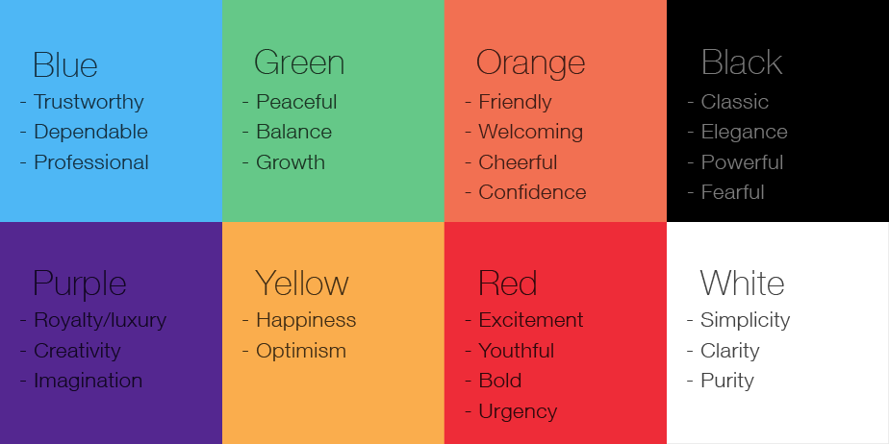
Audience needs – user experience

Slide 52
Audience needs – user interaction
Interaction is what makes the difference between a movie and a dynamic environment
  If you don’t have interactions, you’re a film director, not a game designer
Interaction is extremely dependant on the hardware in use
If your interaction is not natural, nor it is not derived from a standard, you must plan some sort of adaptation to the new mean
Defining what is “standard” or “natural” is hard:
  Is opening a door natural?
  Is using WASD to move a character standard?

Slide 53
When “who” is not real either
Virtual avatars are extremely common in virtual environments
Be careful before creating a digital human:
  Recent studies suggested that human beings react to digital avatars the same
  way they usually react to real people
  There are a lot of lawsuits from common people saying that some digital avatars look like them. Make sure not to be “inspired” too much
When static, avatars are easy to program and animate. When dynamic, the situation gets a little more complex:
  Can they move around space?
  Can they speak?
  Can they perform complex behaviours?

Slide 54
Audience needs – potential problems
Having an expected audience does not mean that exceptions won’t raise
People can have many different impairments:
  Visual (colour blindness, blindness, visual impairment
  Auditory
  Cognitive
  Physical and developmental (tactile, kinaesthetic)
  Financial
It should be your goal to make your application accessible to people with impairments too
  More accessibility, means bigger audience
  8% of male people in the world are colour blind, don’t underestimate the potential of it

Slide 55
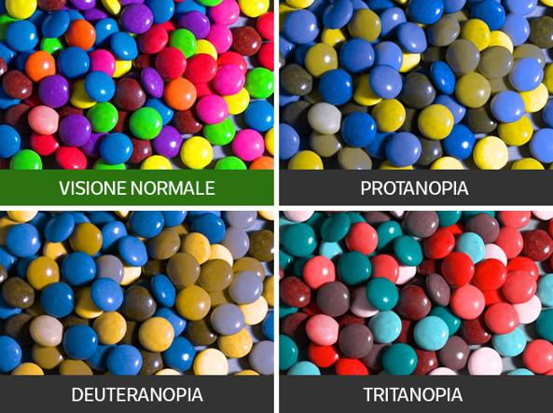
Audience needs – potential problems

Slide 56
In one sentence….
Know your audience, know your environment, and design to blend with both.

Slide 57

Part 3: Final project!

Slide 58
Final exam
There are two possible ways to approach the final exam:
  Written essay regarding one of the topics you’ve discussed with Marcello. During the exam you’ll be asked to discuss the module you’ve chosen, and you’ll be asked to explain at least another module. A Powerpoint presentation is required
  Project. You’ll be required to present a virtual environment, a working prototype of an idea. You have to write a few paragraphs on what you made and what design/structural problems you faced.
On both cases you will have to:
  Discuss the topic with me/Marcello and get it approved. Do not start working on your examination before getting our approval!
  Send your product one week prior to the exam date
Needless to say, we have a strong preference for projects...

Slide 59
Presenting the project
To present your project you need to send:
  A WORKING BUILD for Windows 10 64bits*
  All your source files
  A short essay highlighting the main features of your project
    Not longer than 3 word pages (1 is good enough if it is exhaustive, don’t overdo it) or 10 PPT slides.
Make sure to put both me and Marcello in CC when you submit the project
Do not host your files on a temporary folder (or temporary service such as WeTransfer). Host them on a persistent space until you finish your exam
  Dropbox with a public link should do just fine

Slide 60
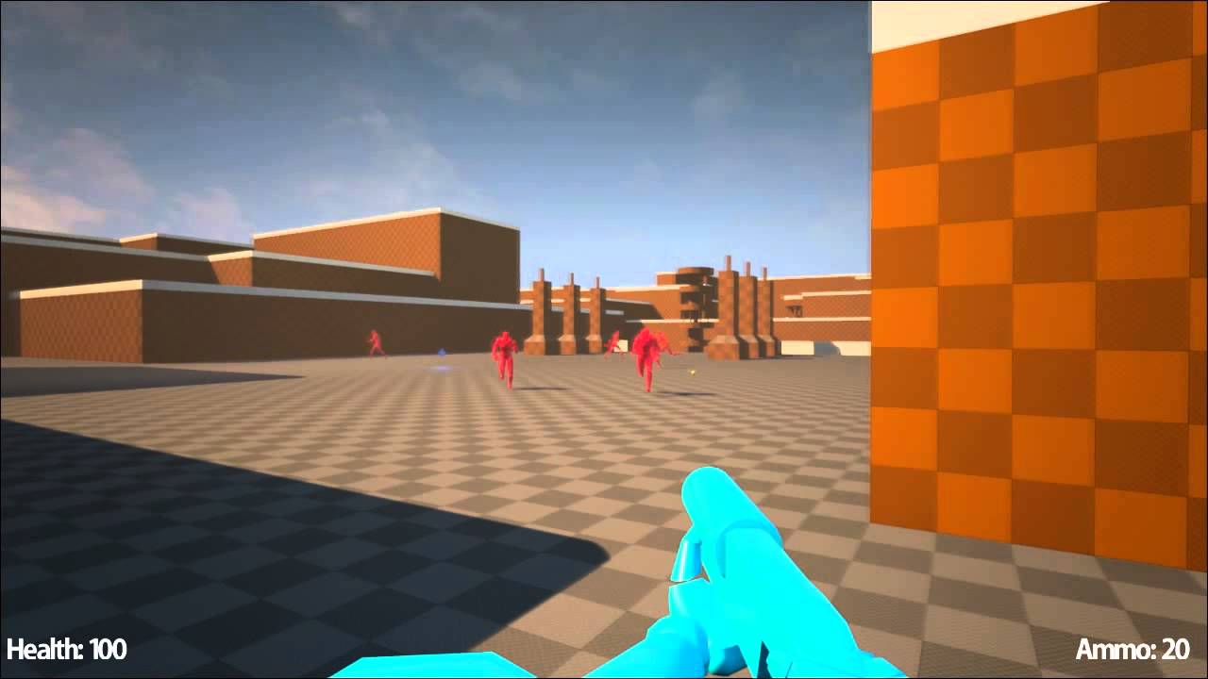
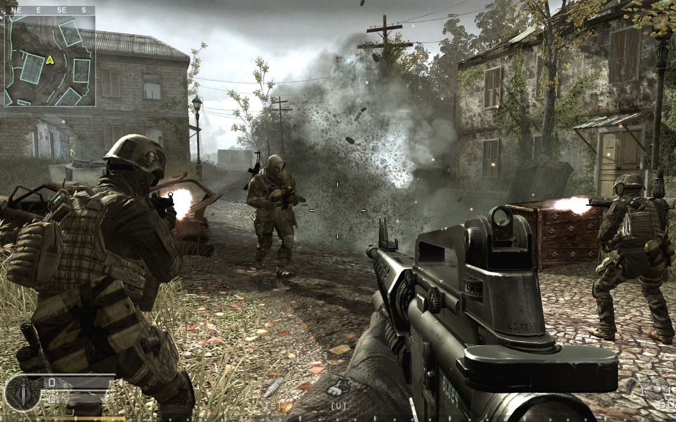
Your projects
We expect a working prototype, with all features in the right place
Graphics is NOT an evaluation criteria!

Slide 61
Do’s and Don’ts
Your artistic skills are NOT part of the exam. Therefore, feel free to download all the assets (visual, acoustic) you want
  Report ALL assets you have included in your project. Failing to report a downloaded asset will be considered plagiarism
InfoUma has a programming prerequisite. Write your own code
  It does not have to be perfect, but it has to be yours
Programming style is subjective. We won’t be judging, as long as:
  You give your folders a consistent structure
  You comment your code
Do not use Unity basic templates in your final projects
  You can still use them to learn basic mechanics

Slide 62
Suggestions!
Recreate a classic 2D game in Unity (either 3D or with enhanced features!)
  Pacman, Arkanoid, Galaga, Space Invaders, Cannon Fodder, Desert Strike, or whatever you like
Underwater submarine platformer
Multiplayer game with 2 tanks attacking each other
Museum of impossible!
Shooter (Top-bottom o FPS) with coordinating enemies/AI
Use players’ voices as main game mechanic
A co-op game where one of the players can be blind

Slide 63
Next episode
Introduction to Unity!
2h of pure hedonistic programming pleasure!
Come prepared:
  Install Unity (versions shouldn’t be a problem, just anything older than 2020)
  Download the asset pack (will post the link the day before the lecture)

Slide 64
Useful books
Game Design:
  The Art of Game Design, Jesse Schell
  A Theory of Fun for Game Design, Raph Kosher
  Rules of Play, Eric Zimmerman,
  Reality is Broken, Jane McGonigal
Programming:
  Game Design Patterns, Robert Nystrom
  Design Patterns: Elements of Reusable Object-Oriented Software, GoF,
  Head First Design Patterns, Elizabeth Freeman

Slide 65
Useful links
Game Design:
  GDC conference YT Channel
  Game Maker’s Toolkit
  Extra Credits
  Design Doc
Others:
  Blender Guru
  CG Cookie ($)
  The Debug Log (Podcast)
Unity-specific links will be posted next time!

Slide 66

«In case I don’t see ya,
good afternoon, good evening,
and good night»
Questions?
17/04/2018

