Slide 1


Controller-free grasping in virtual reality.
A problem of colliding worlds
Speaker: Riccardo Galdieri
21/02/2018

Slide 2

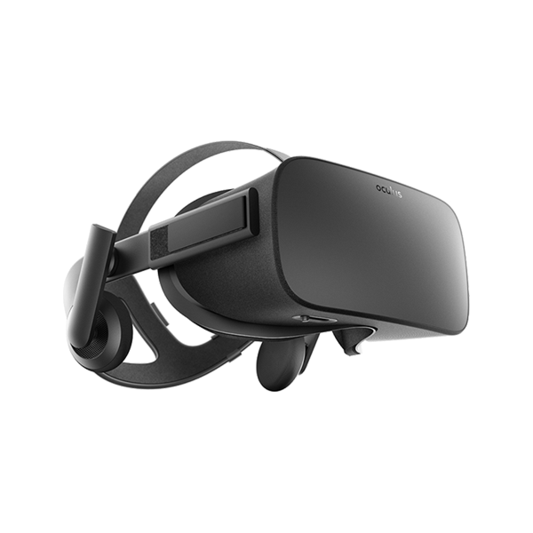
Quick Survey
How many of you have ever tried an immersive VR experience?
21/02/2018

Slide 3
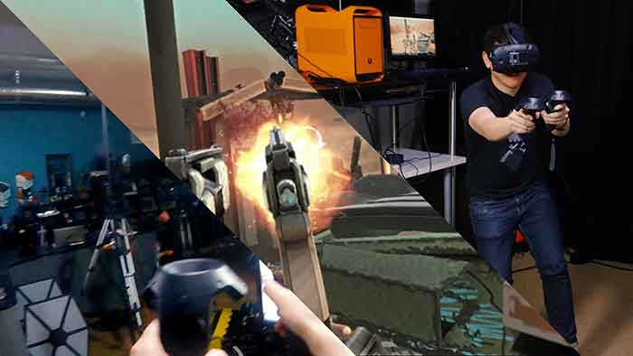
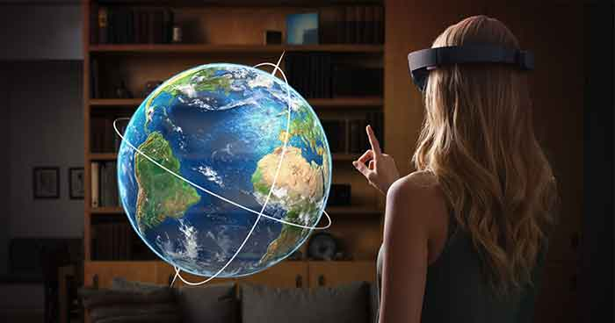
Hands VS Controllers
21/02/2018

Slide 4
Research Questions
Main research questions:
What kind of interaction produce the best results, both in terms of immersion (objective) and presence (subjective)?
Can physics engines be adapted to VR interaction, or they need to be completely rebuilt?
Do we really want to have natural interaction?
21/02/2018

Slide 5
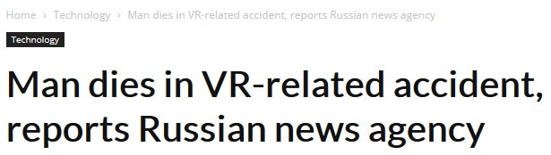
A problem of colliding worlds
Actions from the real world must be translated to the Virtual Environment
Real and virtual worlds do NOT share the same rules, and something that is true in one world could be false in the other.
Virtual Environments’ real time physics was not designed to receive external inputs.
21/02/2018

Slide 6
Hands VS Controllers today
 | PROS | CONS
CONTROLLERS | Extremely precise Can perform non natural gestures Less tiring Less subject to unintended movements | Can break Must be recharged Non natural interaction Need to be learned Different implementation over different platforms and applications
VIRTUAL HANDS | Constant across platforms and applications Natural interaction No learning curve | Still not very precise A lot of noise Tiring after a while Hard to obtain physical interaction
21/02/2018

Slide 7
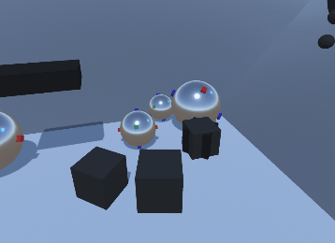
A new hybrid approach
The solution we are currently proposing and experimenting on is to use a non-physical approach for borderline-cases
Currently doing comparative studies on how people perceive these two different types of input
21/02/2018

Slide 8
Conclusions
Controllers are a good short term solution
Thinking about interaction we can only assert that:
  Current physics implementation can’t handle hands-free interaction as it stands
  Current controller-free solutions are unreliable
  Influence of controllers-free interaction on presence has yet
  to be confirmed by data, but it looks promising
21/02/2018

Slide 9
Thank you!
Questions?
21/02/2018

