Slide 1


Science!
A (Semi) serious introduction
Speaker: Riccardo Galdieri
Notes:
If I am too serious you all fall asleep
Science is fun, why make it sound boring?

Slide 2
Level 0: who am I?

Slide 3

About me
3rd year PhD Student in Emerging Digital Technologies at Scuola Superiore Sant’Anna (Pisa, Italy) – Visiting Staff at BUas!
Currently working with Mata and Thomas on understanding how players interact with virtual environments. This means we’re trying to catalogue:
  Players’ subconscious behaviours
  Previous knowledge influence
  Importance of environmental factors and UI
  Players’ relationship with controllers
    https://rgaldieri.itch.io/escapetower-desktop
Helping spread the User Generated Stories (more from Thomas)
  ugs.guraas.com

Slide 4
About me
Bachelor Degree in Digital Humanities
  Thesis on using Markov Chains to perform authorship attribution on fictional characters
Master Degree in Digital Humanities
  Thesis on developing tools to improve museum exhibitions design (huge disappointment)
Study abroad experiences:
  King’s College London (2012-2013)
  National Taiwan University (2014-2015)

Slide 5
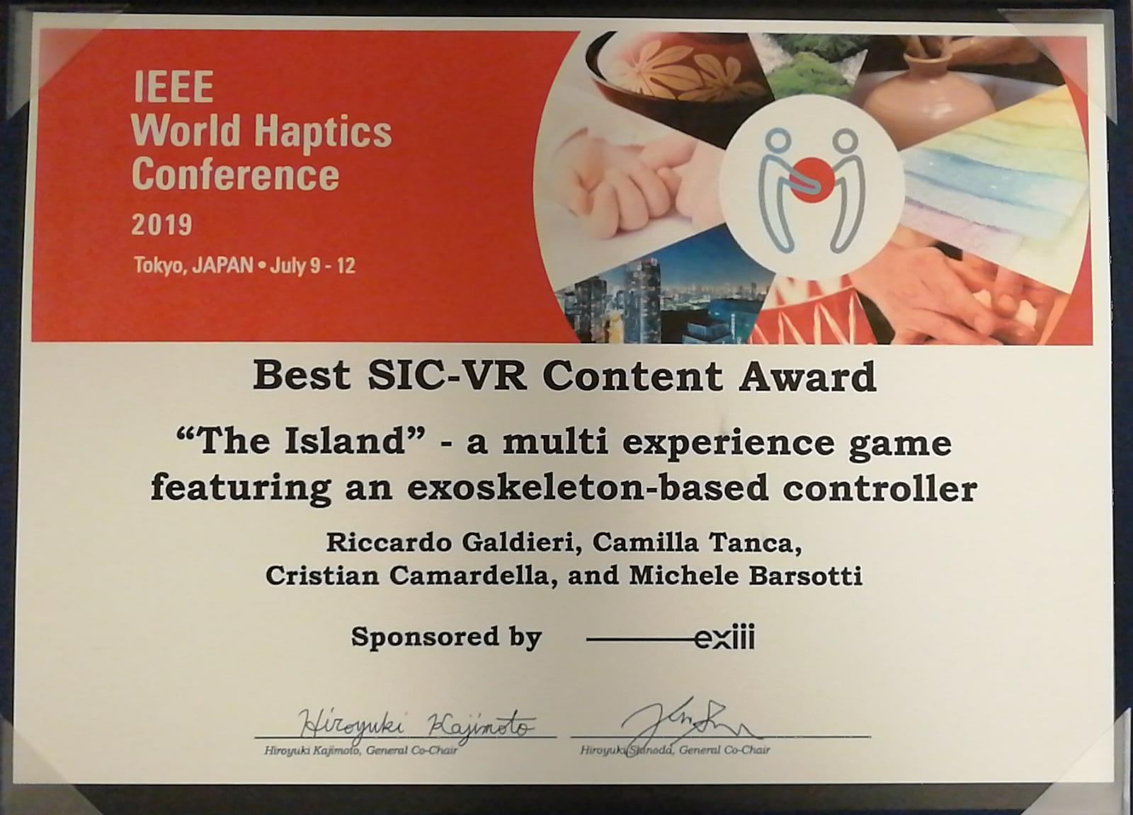
About me
VR «expert» (or whatever that means)
Other research interests: Human-computer interaction, interaction metaphors in immersive virtual environments (VR), digital cultural heritage

Slide 6
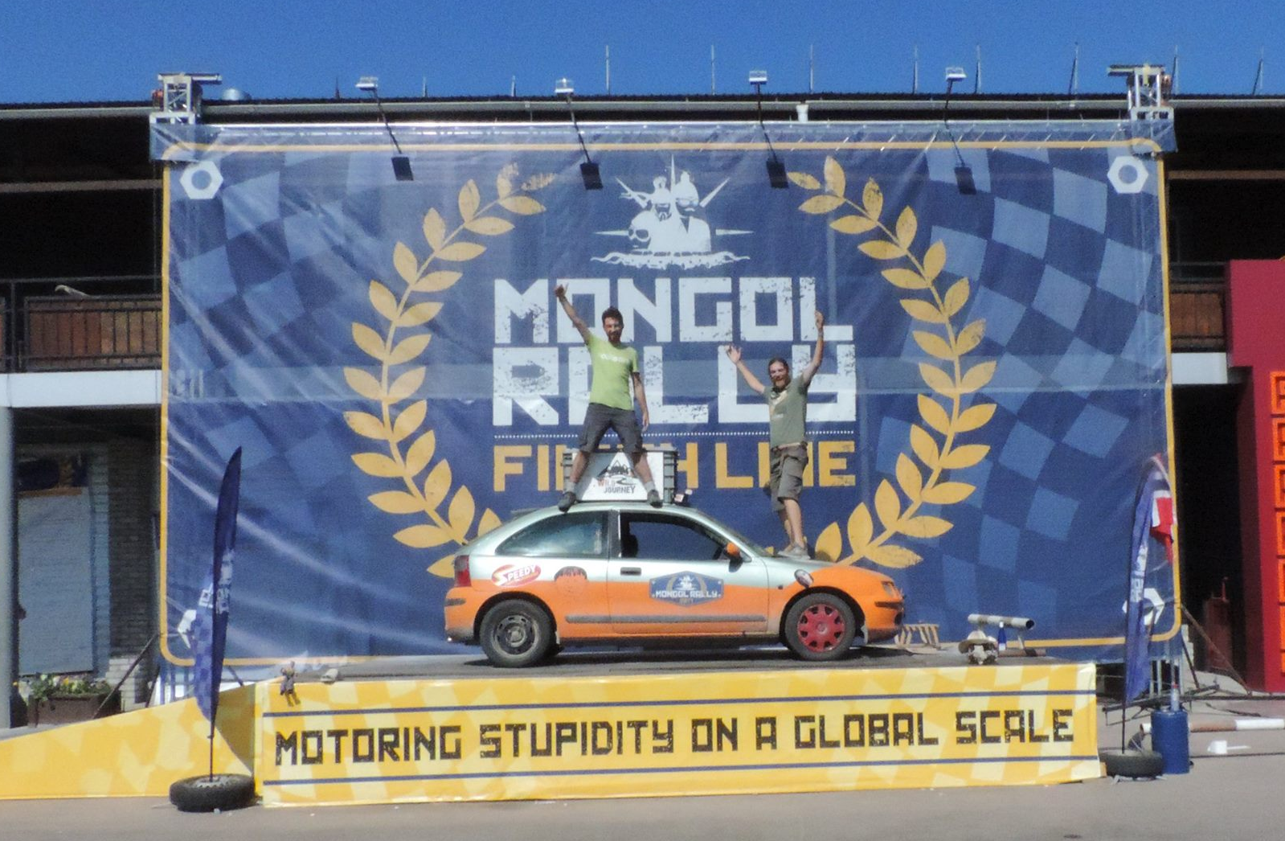
About me
Experienced backpacker (mainly Europe and Asia)
Mongol Rally Veteran
“I was about to put an applicant in
the "maybe" pile, when I saw he’d
led a 100km hike in the Himalayas.
The kind of persistence it takes to
do a 100km hike in the Himalayas
is the kind of persistence it takes
to do research.”
- Matt Might
Notes:
Matt Might is Professor of Internal Medicine and Computer Science
http://matt.might.net/articles/how-to-apply-and-get-in-to-graduate-school-in-science-mathematics-engineering-or-computer-science/

Slide 7
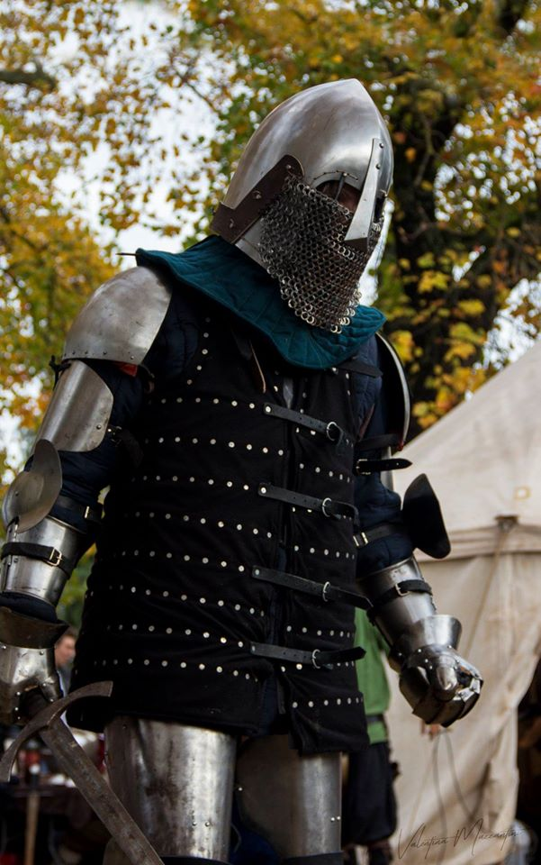
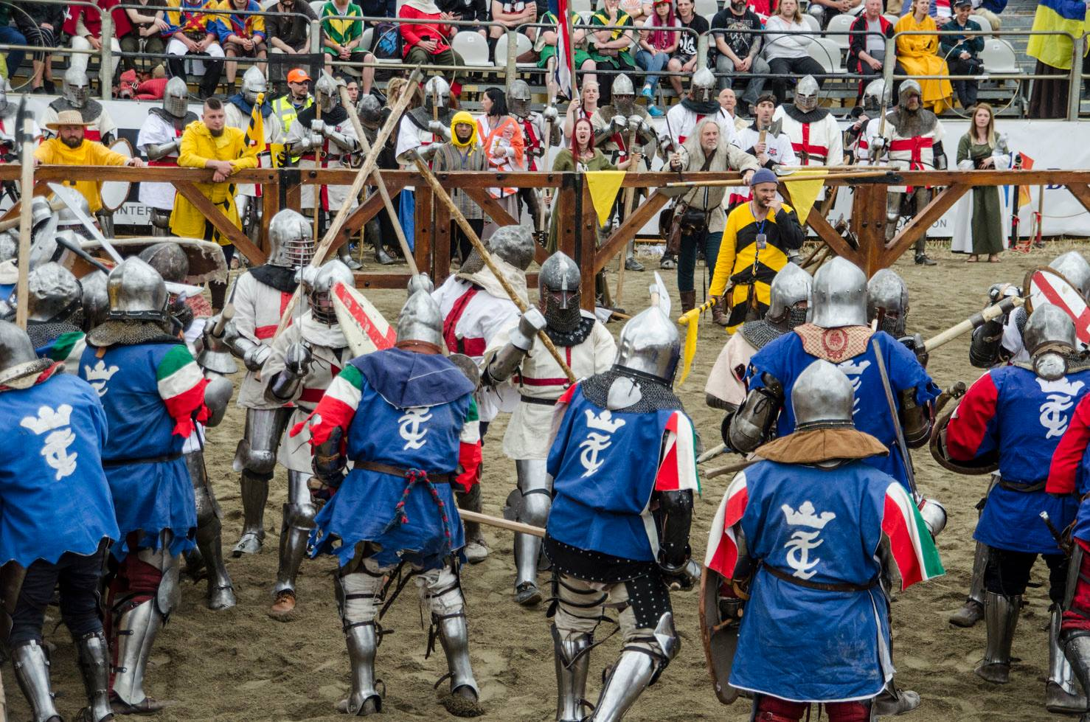
About me
Experienced backpacker (mainly Europe and Asia)
Mongol Rally Veteran
Medieval sword fighter (HMB)

Slide 8
What am I doing here today
I’m here to teach you how to «Science!»
On a theoretical side, we’ll see:
  How to ask the right questions
  How to get the right answers
  How to get rid of potential biases
On a practical side, we’ll see:
  How to write a paper
  How peer review works
And hopefully we’ll have a laugh!

Slide 9
How to take this lecture
I am not a professor, I will not grade you in any way, nor I will write any report to anyone.
  Please, PLEASE, feel free to interact with me and ask any question, for as dumb as they may sound to you
There are some useful links in the notes attached to this presentation
The slides will be available at some point on my website
  riccardogaldieri.com/teaching
For any question regarding your projects and how to handle it from a scientific point of view, we can arrange a meeting! Just reach me at:
  riccardo.galdieri@santannapisa.it

Slide 10
After this lecture
I will be more than happy to help
you make your research solid.
If you have any doubt on your
methodology or any of the
things we are going to see
today, send me an email
and we’ll try to find a solution!

Slide 11
Section 1: how to Science!
“Science never solves a problem without creating ten more” - George Bernard Shaw

Slide 12
What is science
Science has a thousands possible definitions:
  “The systematic study of the nature and behaviour of the material and physical universe, based on observation, experiment, and measurement, and the formulation of laws to describe these facts in general terms”
  “Science is the study of the nature and behaviour of natural things and the knowledge that we obtain about them “
  “The intellectual and practical activity encompassing the systematic study of the structure and behaviour of the physical and natural world through observation and experiment”
What do these things have in common?

Slide 13
Theoretical VS applied sciences
You are doing applied sciences, which means that your approach should be more practical
  Does this mean that you can just build things with a screwdriver and expect people to understand them? (Short answer: NO)
A scientist seeks a model to match a physical system, while an engineer seeks a physical system to match a model
  You are still scientists!
Classic research aims to advance knowledge on a specific subject, with little concern for practical benefits in the short term. Applied research aims to achieve PRACTICAL outcomes that are useful to society

Slide 14
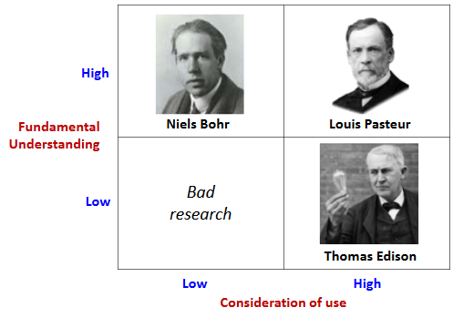
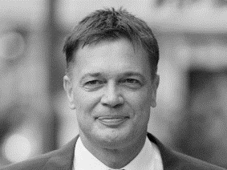
Theoretical VS applied sciences
Good research is always characterized by a rigorous scientific study aimed at advancing knowledge and producing new results that will be useful for the society
Andrew Wakefield

Slide 15
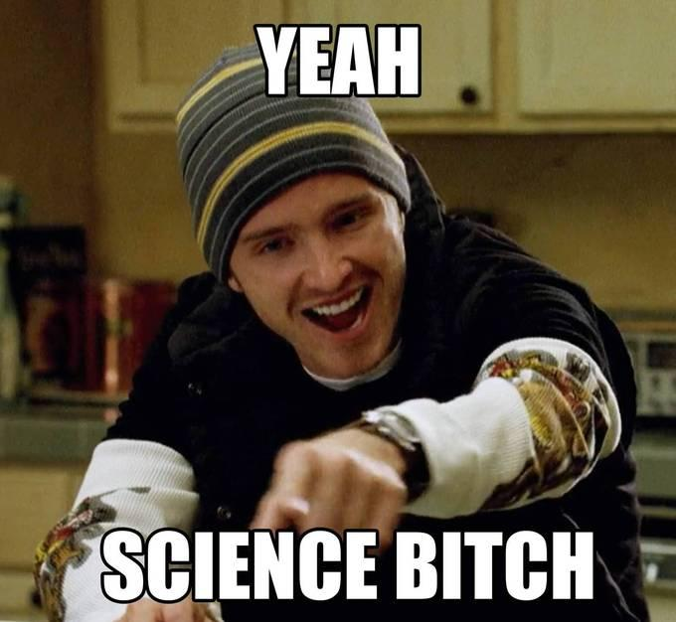
How to make science
There are two important things that we need to make science:
  Method
  Principles
The method – also called the scientific method – is used to make your research rigorous and objective
The principles – also called scientific principles – are used to
give you guidelines on how to evaluate your research with
logics and ethics
Make sure you have something to write on, you’ll need it!

Slide 16
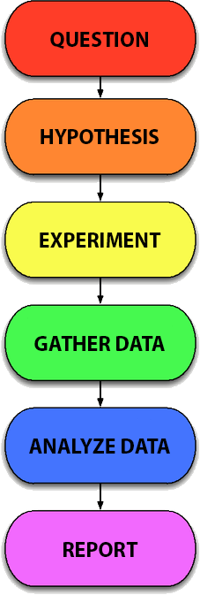
The Scientific Method
The scientific method is a process for experimentation that is used to explore observations and answer questions.
The scientific method is not “set in stone”, but is often adapted to the discipline
  Good luck experimenting on dinosaur fossils
As linear as it usually portrayed, the scientific method is ITERATIVE
  You get good data? Change the hypothesis
  You don’t get good data? Change the experiment
Notes:
SOURCE: https://www.sciencebuddies.org/science-fair-projects/science-fair/steps-of-the-scientific-method
https://en.wikipedia.org/wiki/Timeline_of_the_history_of_scientific_method

Slide 17
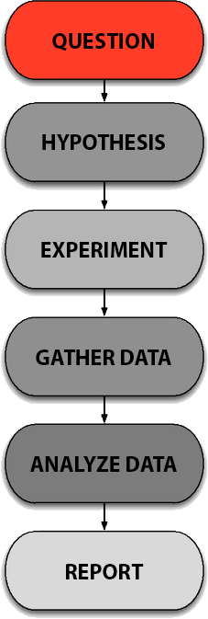
The Scientific Method
The scientific method starts when you ask a question about something that you observe
Your question must solve a new problem*
  Has anyone ever performed the same experiment? In what conditions? Is your contribution adding something to the current scientific knowledge?
The question can refer to the explanation of a specific observation, as in "Why is the sky blue?" but can also be open-ended, as in "How can I design a drug to cure this particular disease?"
Notes:
Replication studies are a different thing.
https://www.researchgate.net/post/What_is_replication_in_research

Slide 18
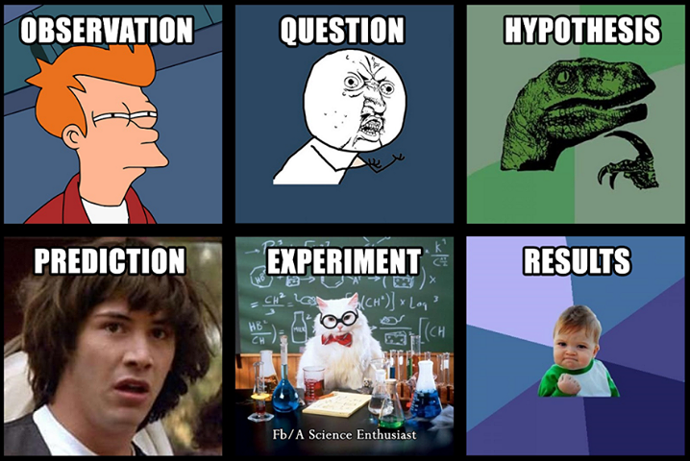
The Scientific Method
What is the question you are trying to answer with your research?

Slide 19
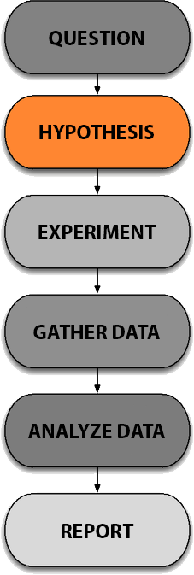
The Scientific Method
Once you have a well-defined question, ask yourself: “How can I potentially find an answer”
A hypothesis is an educated guess about how things work.
  It is an attempt to answer your question with an explanation that can be tested.
A good hypothesis allows you to then make a prediction:
"If ____[I do this] ____, then _____[this]_____ will happen.“
State both your hypothesis and the resulting prediction you will be testing. Predictions must be easy to measure.

Slide 20
The Scientific Method
What is your current hypothesis? Is it providing a reasonable answer to your question?

Slide 21
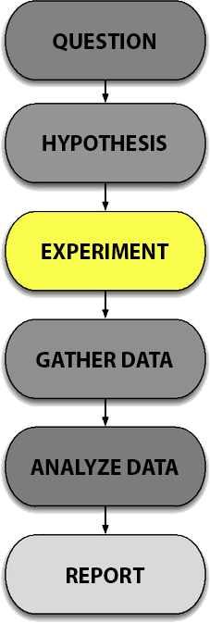
The Scientific Method
You have a question and an intuition on how to answer it. Build a system that confirms it!
  If you like what you do, this is supposed to be the funniest part. If you don’t, probably the ugliest!
The experiment should be BIAS FREE
  Any possible factor that influence your research must be accounted for and reported (more about this later)
You should also repeat your experiments several times to make sure that the first results weren't just an accident
Build stuff. Break it. Change something. Break it again!

Slide 22
The Scientific Method
What experiments are you currently planning? Can you list at least three different variations?

Slide 23
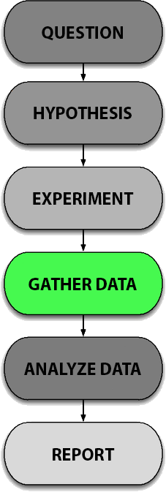
The Scientific Method
No matter what stage of your project you are at, always gather data!
  You never know when something will work
You should give your data a structure
  What are the input parameters?
  What are the environment conditions?
  What is producing the transformation?
  What output are you receiving?
Mark the project version that has been used to collect each single piece of information you have (including test data)

Slide 24
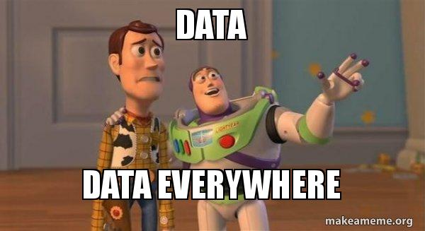
The Scientific Method
Have you collected any data yet? Is it well structured?

Slide 25
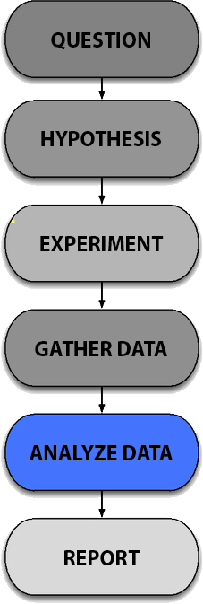
The Scientific Method
Making sense of your data is what makes the difference between shallow and a deep research
Having opposite results from what you expected is as valuable as having good data
  Disproving a theory is as valuable as proving it (if not more)
If you get a 50% score in any value, you’re ùallowed to cry
  can anyone tell me why?

Slide 26
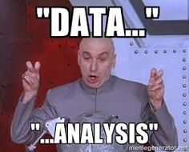
The Scientific Method
What is your data telling you?

Slide 27
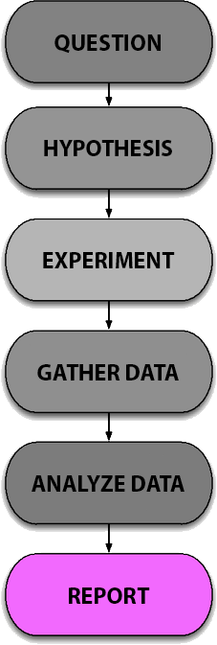
The Scientific Method
When you are done with your project, if you followed the right procedures, you need to let the world know!
  If you don’t publish your experiment, you don’t have an experiment
There are conventional and unconventional ways to share scientific work
  Gamasutra is not a conventional scientific channel, doesn’t mean that you can’t post it there
Bad results are also worth being published, if your experiment has followed the scientific method!
  More about this later!

Slide 28
The Scientific Method
How are you planning on sharing your results?

Slide 29
Do you feel like sharing soemthing you wrote?
Especially if you are NOT convinced about it

Slide 30
Congratulations! How you have the basics to make science! But this is not enough
  Can you tell me why?

Slide 31
The Scientific principles
Congratulations! How you have the basics to make science! But this is not enough
The scientific method tells you how to do research, but it does not give you MORAL principles.
  Most of these have been defined by philosophers
Moral, like many other things, is subjective and context-dependent, but in the scientific community is (almost) universal
Scientific principles are not universally recognized, but can save you from losing an argument, a grant, or your job!
Let’s see a few important ones

Slide 32
Argumentum ad hominem
According to Wikipedia: “fallacious argumentative strategy whereby genuine discussion of the topic at hand is avoided by instead attacking the character, motive, or other attribute of the person making the argument, or persons associated with the argument, rather than attacking the substance of the argument itself”
In simpler words, attacking the person and not the argument
DO NOT EVER DO THAT (leave it to politicians)
On the Graham's Hierarchy of Disagreement comes just before Name-calling
  Which means that worse than this, there’s only being childish
Notes:
https://en.wikipedia.org/wiki/Ad_hominem
https://en.wikipedia.org/wiki/Paul_Graham_(programmer)#Graham's_Hierarchy_of_Disagreement

Slide 33
Let’s play a game!
Let’s play a game!
We’re going to read a few quotes, tell me which one you agree the most with
  These are not binaries, you can agree with both, one, or none
You can also try to guess who is the lovely author of those sentences!
(You’re going to hate me in a minute)

Slide 34
Guess the quote!
“Words build bridges into unexplored regions”
“Long live the walls we crashed through”
Notes:
Hitler and tailor swift

Slide 35
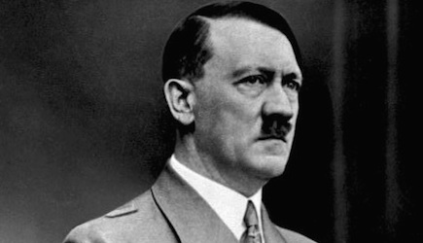
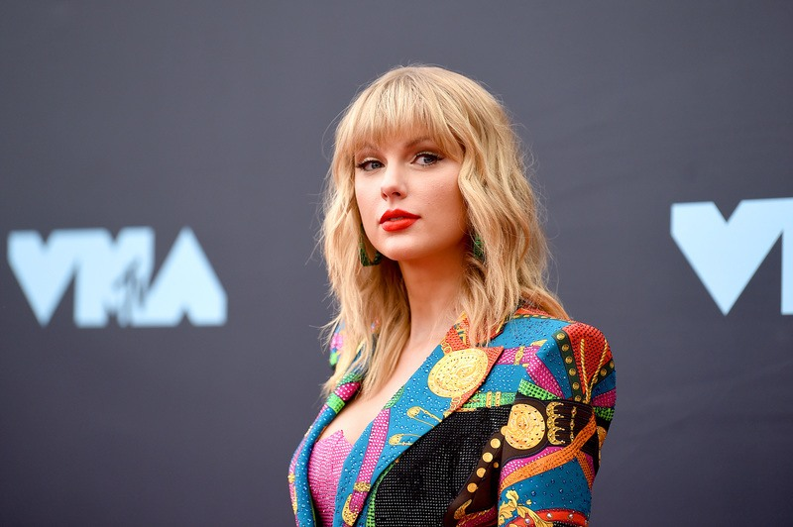
Guess the quote!
” Words build bridges into unexplored regions”
” Long live the walls we crashed through”
Notes:
Hitler and tailor swift

Slide 36
Guess the quote!
“It is true that the Muslim world
is not totally mistaken when it reproaches the West of Christian tradition of moral decadence and the manipulation of human life.”
”I believe in one thing only, the power of human will”
Notes:
Stalin and the pope

Slide 37
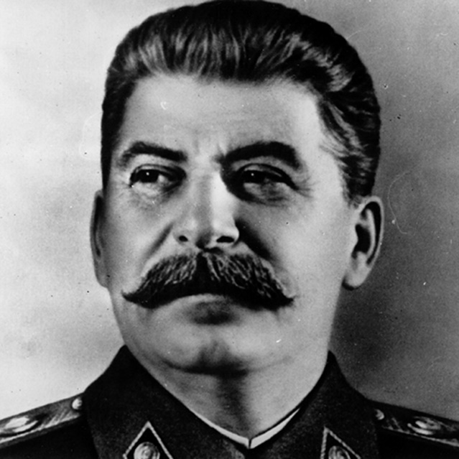
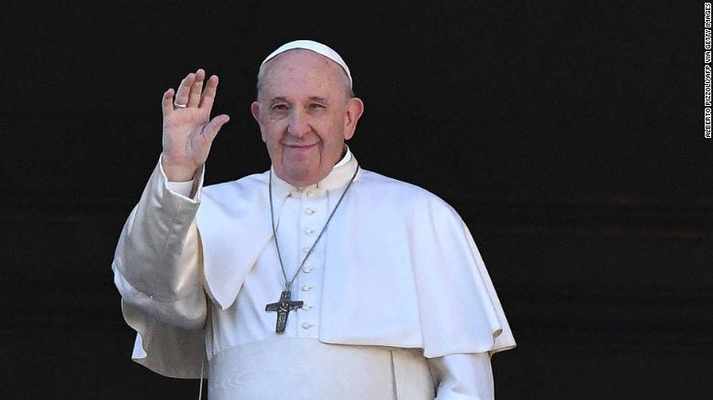
Guess the quote!
“It is true that the Muslim world is not totally mistaken when it reproaches the West of Christian tradition of moral decadence and the manipulation of human life.”
”I believe in one thing only, the power of human will”
Notes:
Stalin and the pope

Slide 38
Guess the quote!
“The real strong have no need to prove It to the phonies”
“Italy receives the trash from Africa, homeless and beggars all over the street. I wonder why Italy and Europe accept and tolerate the presence of these migrants, that behave like rats that pest the city”
Notes:
Charles manson and serge boret bokwango , Congolese diplomat

Slide 39
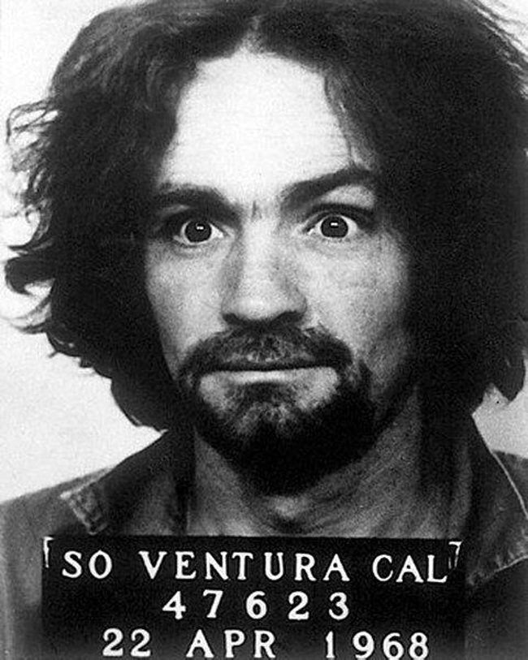
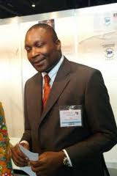
Guess the quote!
“The real strong have no need to prove It to the phonies”
“Italy receives the trash from Africa, homeless and beggars all over the street. I wonder why Italy and Europe accept and tolerate the presence of these migrants, that behave like rats that pest the city”
Notes:
Charles manson and serge boret bokwango , Congolese diplomat

Slide 40
Guess the quote!
By now, there is a chance that you are less inclined to agree with
the quotes because you are afraid to agree with people you don’t like!

Slide 41
Guess the quote!
“Equality Means Nothing Unless Incorporated Into the Institutions”
”Black people are troublesome,
very dirty and live like animals”
Notes:
Slobodan Milosevic and Mahatma Gandhi

Slide 42
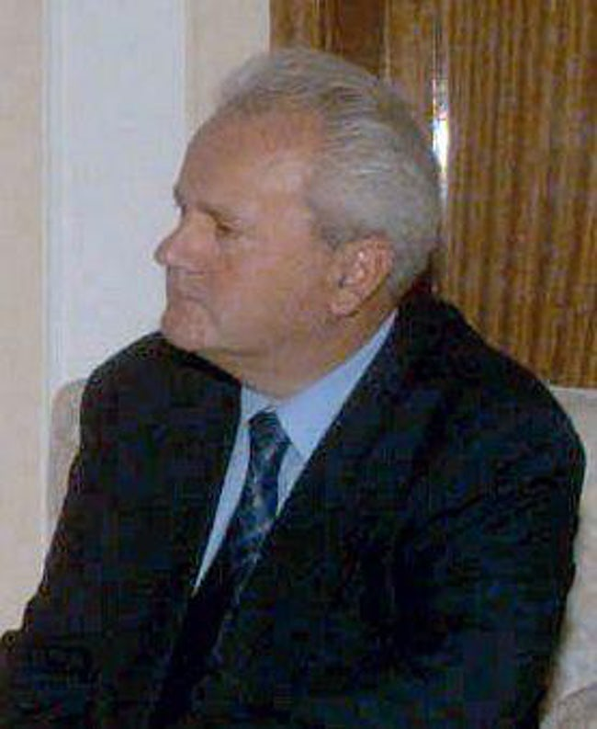
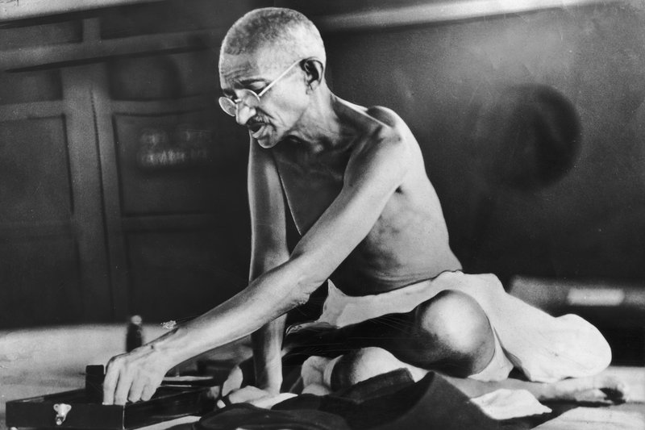
Guess the quote!
“Equality Means Nothing Unless Incorporated Into the Institutions”
”Black people are troublesome,
very dirty and live like animals”
Notes:
Slobodan Milosevic and Mahatma Gandhi

Slide 43
Guess the quote!
“Never forget that everything Hitler did in Germany was legal”
“Intelligence plus character — that is the goal of true education”
Notes:
Martin Luther king

Slide 44
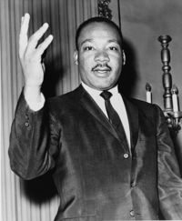
Guess the quote!
“Never forget that everything Hitler did in Germany was legal”
“Intelligence plus character — that is the goal of true education”
Notes:
Martin Luther king

Slide 45
Guess the quote!
”Years from now, people will find our acceptance of the HIV theory of AIDS as silly as we find those who excommunicated Galileo.”
“Let me tell you about my trouble with girls. Three things happen when they are in the lab: you fall in love with them, they fall in love with you, and when you criticize them they cry. Perhaps we should make separate labs for boys and girls?”
” The illegal we do immediately. The unconstitutional takes a little longer”

Slide 46
Guess the quote!
” Years from now, people will find our acceptance of the HIV theory of
AIDS as silly as we find those who excommunicated Galileo.”
    - Kary Mullis, Nobel Prize in Chemistry (1998)
“Let me tell you about my trouble with girls. Three things happen when they are in the lab: you fall in love with them, they fall in love with you, and when you criticize them they cry. Perhaps we should make separate labs for boys and girls?”
  - Sir Tim Hunt, 2001 Nobel Prize in Physiology and Medicine (2015)
” The illegal we do immediately. The unconstitutional takes a little longer”
    - Henry Kissinger, 1973 Nobel Peace Prize

Slide 47
Guess the quote!
Talking about Africa: “all our social policies are based on the fact that their intelligence is the same as ours, whereas all the testing says, not really.”
in 2000, suggesting the skin pigment melanin boosts sex drive: "That's why you have Latin lovers," he said. "You've never heard of an English lover. Only an English patient.“
“some anti-Semitism is justified. Just like some anti-Irish feeling is justified. If you can’t be criticized, that’s very dangerous. You lose the concept of a free society

Slide 48
Guess the quote!
Talking about Africa: “all our social policies are based on the fact that their intelligence is the same as ours, whereas all the testing says, not really.”
in 2000, suggesting the skin pigment melanin boosts sex drive: "That's why you have Latin lovers," he said. "You've never heard of an English lover. Only an English patient."
“some anti-Semitism is justified. Just like some anti-Irish feeling is justified. If you can’t be criticized, that’s very dangerous. You lose the concept of a free society
James Watson, 1962 Nobel Prize in Physiology or Medicine for their discoveries concerning the molecular structure of nucleic acids (DNA)

Slide 49
Guess the quote!
I think I made my point clear…

Slide 50
Falsifiability
For a claim to be meaningful, it must in principle be falsifiable, that is, capable of being disproven
  Karl Popper called it “the line between science and pseudo-science”
Falsifiability is NOT the opposite of verifiability
Example: “All cars in the world are black”
  Verifiability would require you to know ALL cars
  For falsifiability, you just need a non-black one!
Bottom line: do not make claims that cannot be falsified!
  You should actually encourage people to challenge your assumptions
Notes:
“Karl Popper is generally regarded as one of the greatest philosophers of science of the 20th century. He was also a social and political philosopher of considerable stature, a self-professed critical-rationalist, a dedicated opponent of all forms of scepticism, conventionalism, and relativism in science and in human affairs generally and a committed advocate and staunch defender of the ‘Open Society’.”

Slide 51
Replicability
Replicability refers to whether the results from your test or experiment can be replicated if repeated exactly the same way
In order to demonstrate replicability, you must provide statistical evidence that shows your results can be used to predict outcomes in other experiments.
Are you sharing all the data that is required to perform the same experiment, with the same condition, and are you fully dislcosing your results?
Articles that cannot be replicated are often retracted
  (more about it in the paper section)

Slide 52
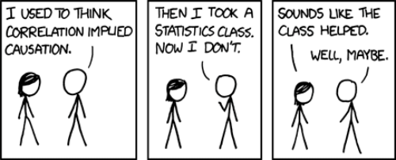
Correlation vs. Causation
A correlation between two things doesn't prove a causal connection between them
Correlation is the relationship between two sets of variables used to describe or predict information
  Can be measured through a normalized scale (-1.0, 1.0)
  Positive correlation implies that both variables move the same way
  Negative correlation that are moving in different directions
Causation is when an observed event
or action appears to have caused
a second event or action

Slide 53
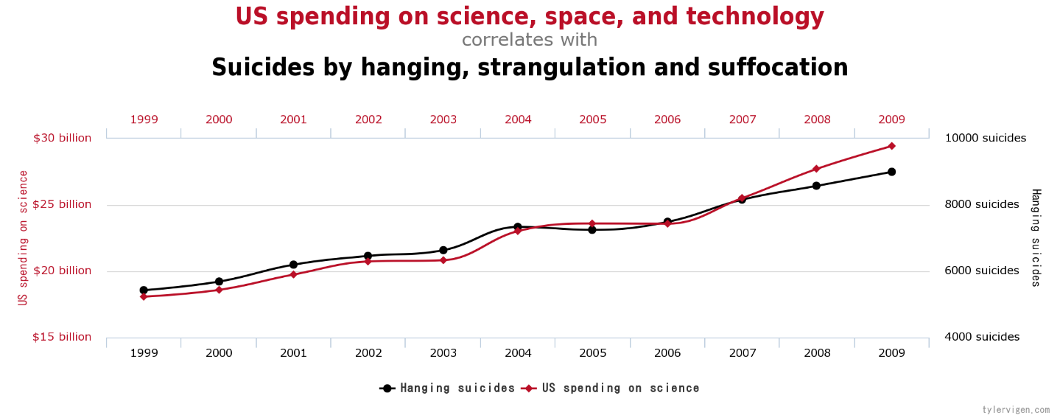
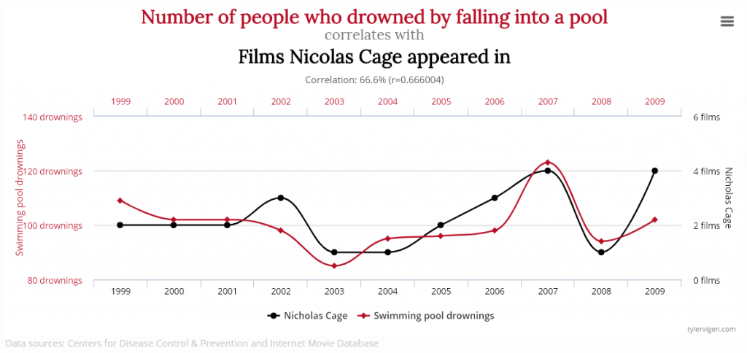
Correlation vs. Causation

Slide 54
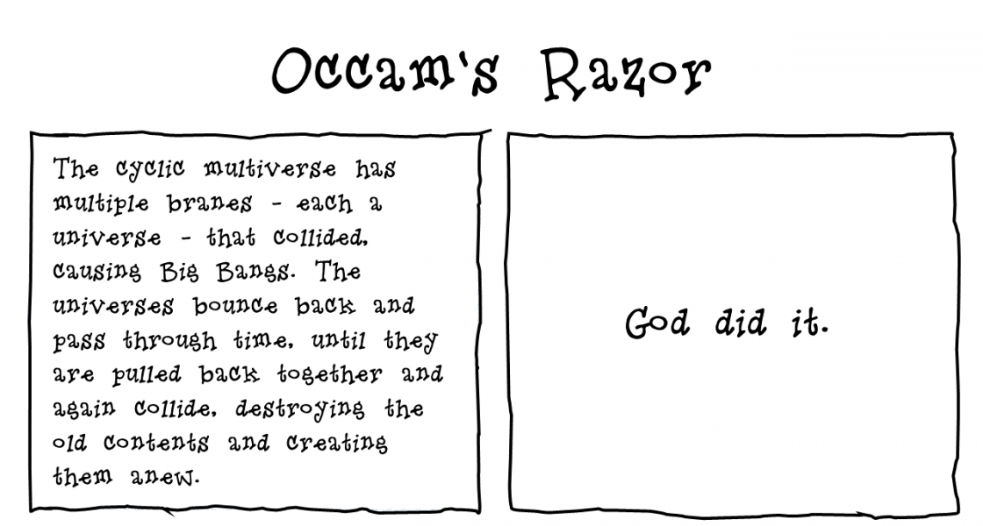
Principle of parsimony
Also known as Occam’s Razor
If two explanations for a phenomenon are equally good, we should generally select the simpler one
  All explanations need to have explanations of equal scientific value!
Notes:
Second explanation is not false, it is just not provable (again, falsifiability)

Slide 55
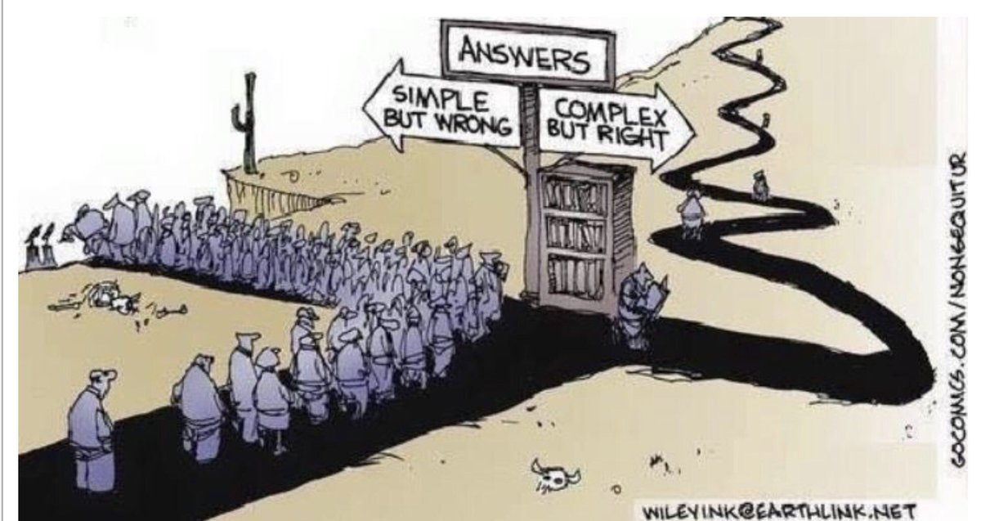
Be careful with the Occam’s Razor

Slide 56
Ruling out rival hypotheses
Heavily based on Occam’s Razor
To rule out rival hypotheses is to exclude other possible explanations for a specific claim
  Before asserting something, we must make sure that other explanations have been disproven
The fact that you already have a simple answer does not mean that you should stop looking!
Extremely hard, especially in medical sciences, because of the placebo effect
Notes:
Second explanation is not false, it is just not provable (again, falsifiability)

Slide 57
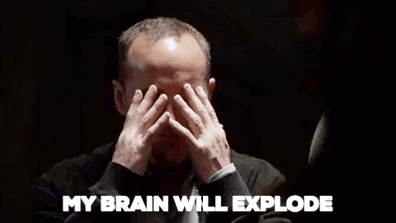

Slide 58
Section 2: academia!
“Academic and aristocratic people live in such an uncommon atmosphere that common sense can rarely reach them” – Samuel Butler

Slide 59
How to do research
So far we have seen how to conduct an experiment and how to keep it
above minimum standards
However, to get other people to accept your work as valid and scientific, there are a few more things that you need to consider
  Are you communicating through the conventional channels?
  Is your work based on other people’s work?
  Is your work solid in terms of methodologies, procedures and understanding of the subject?
  Has your experiment been conducted within universally recognised boundaries of ethics and reason?

Slide 60
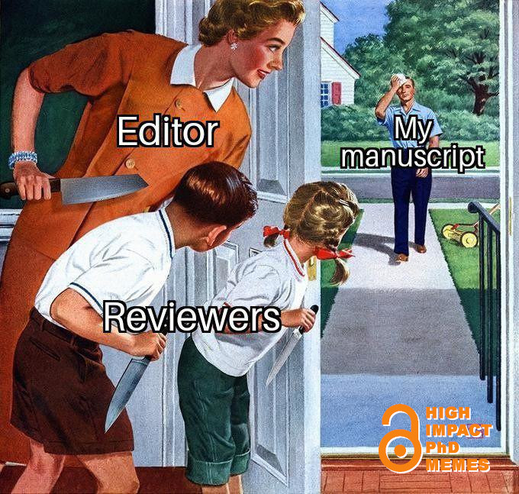
Scientific papers
There are official channels through which science is shared, discussed, and most importantly, evaluated
  Regardless of the channel, you are always required to publish a PAPER (or a book)
You work will be evaluated by a commission of peers,
who’ll grade how solid your work is, and either
approve or reject it
  Peer review is often “blind”, meaning that the
  reviewers will not know who the author
(I am assuming that you have already seen how to
write a scientific paper)

Slide 61
Why should you care
If you do not publish your results, nobody will know them and nobody can use them
When a result is found by more than one researcher, the credit goes to the person who publishes it first
If you work in the academia, you are going to be evaluated on your publications
  The number of publications is important, but not everything (Quantity does not equal quality)
  Your need people to quote your work for their own research!

Slide 62
However....
The process of writing a papers is not intuitive and it has never been formalized
Often, students produce interesting research results, but they have big troubles to have them published
Typically, the reasons for a rejection are not technical, but due to the presentation
  Wrong format, missing literature review, wrong length, wrong vocabulary, not-so-clear explanation of methodologies and data….
For the remaining time we will focus on how to make you scientists!

Slide 63
Publication
Once you have conducted an experiment, you (ideally) want other people to know about it
The way you do it in science is through publication
Scientific publications (Often known just as papers) are where results and knowledge derived by science are shared and taught to others in the world
  If it is not published, it does not exist!
There are many ways to have your work distributed:
  Conferences, Journals, workshop, reports

Slide 64
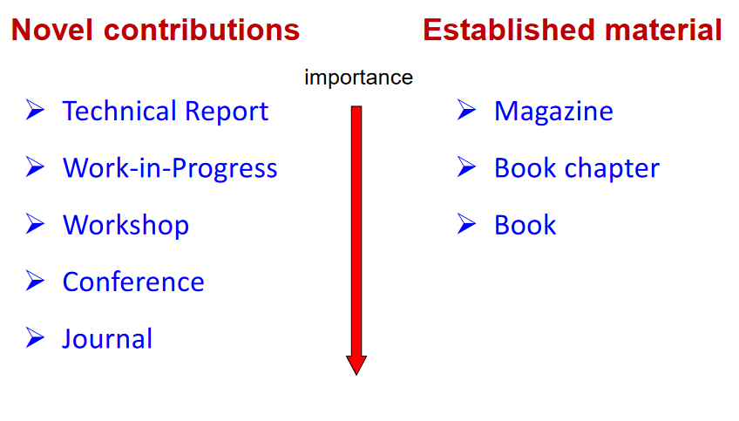
Publication*
Notes:
http://retis.sssup.it/~giorgio/slides/h2d/h2d.html

Slide 65
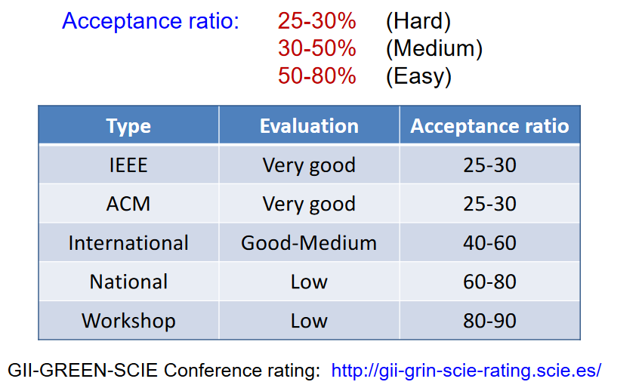
Conference Ranking

Slide 66
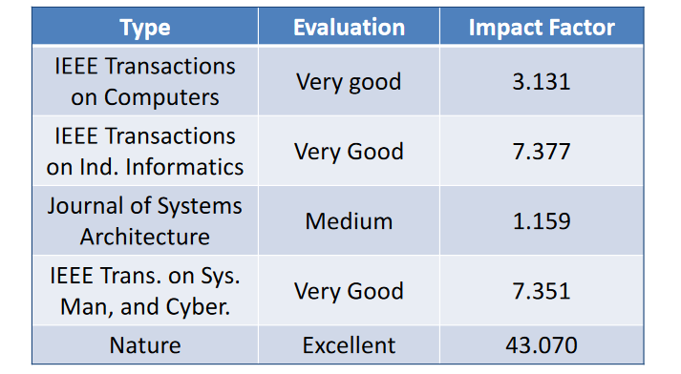
Impact factor
Journals and conferences are evaluated by their Impact factor
  The index measuring the average number of citations to recent published articles

Slide 67
Journal ranking
Journals can be evaluated through the Scimago Journal Ranking (SJR Indicator)
  It accounts for both the number of citations received by a journal and the importance of the journals where such citations come from (H-Index)
  It divides the citations by discipline!

Slide 68
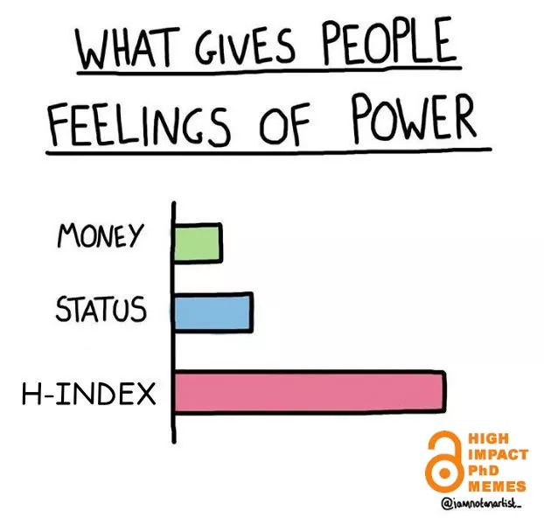
Journal ranking

Slide 69
Journal ranking
https://www.scimagojr.com
Find a journal that could suit your topic of interest, and get some data about them
  What review process are they using?
  What’s their H-Index?
  What is their template?
  Are they accepting submissions?
Notes:
http://retis.sssup.it/~giorgio/slides/h2d/h2d.html

Slide 70
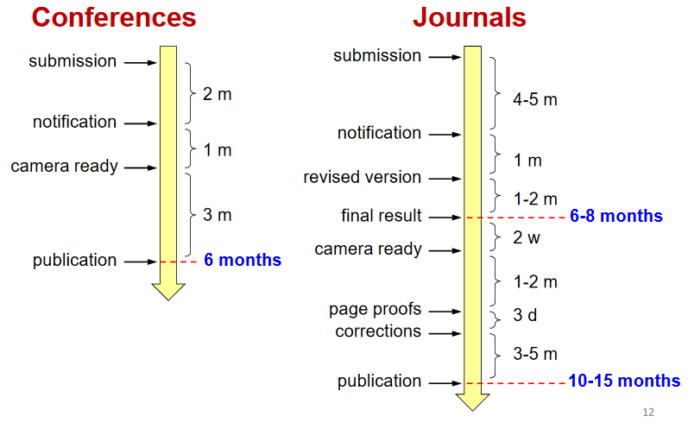
Publication time
Conferences and journals have VERY different schedules
Plan accordingly!

Slide 71
The submission process
Each conference journal has its own set of rules for submission
Make sure to:
  Use the template that the journal/conference has provided
  Be within the page limit (Harder than it sounds)
  Follow the submission deadlines (usually around 6 months before the conference and 9-12 before journal publication)
  Write something of interest for the journal/conference you’re targeting. A list of topics of interest can be found on any conference/journal website page

Slide 72
Notification
Paper can either be accepted, accepted with minor revision, accepted with major revision, or rejected:
  Accepted: great! You can celebrate!
  Accepted with minor revision: good! Your paper has been accepted, but some minor modifications have been asked (you surely screwed something with bibliography or templates)
  Accepted with major revision: okay! your paper cannot be accepted as it is, but requires some major changes. The revised paper need to be checked again by the reviewers
  Rejected: bad, you need to keep working on it!

Slide 73
Notification
Decisions are FINAL
  Even if a review is wrong, or you don't agree, the decision cannot be changed. The only thing you can do is to write a letter of complain to the conference chair (Don’t)
Don't give up. Try the next conference, but don't leave the paper unchanged!
  Regardless of the result, you always receive a feedback from your reviewers. That is GOLD, especially in case of rejection
Address all reviewers' comments, even those you think are wrong

Slide 74
Typical reactions
“The reviewer didn't understand my paper”
  May be, but it's your job to ensure that anyone can correctly understand your work. Perhaps some parts were not as clearly explained as you think
“The reviewer didn't get the message”
  It could be, but it's your job to express it well. You can improve the presentation making some thing smore explicit and highlighting the parts that were not understood
“We were invited for submission”
  Being invited means that they like your work, not that you are free to write whatever you like. Your work is always reviewed (and I know it well)
Notes:
Tell them about the EuroVR paper…

Slide 75
Section 3: tips & tricks!
“The saddest aspect of life right now is that science gathers knowledge faster than society gathers wisdom” – Isaac Asimov

Slide 76
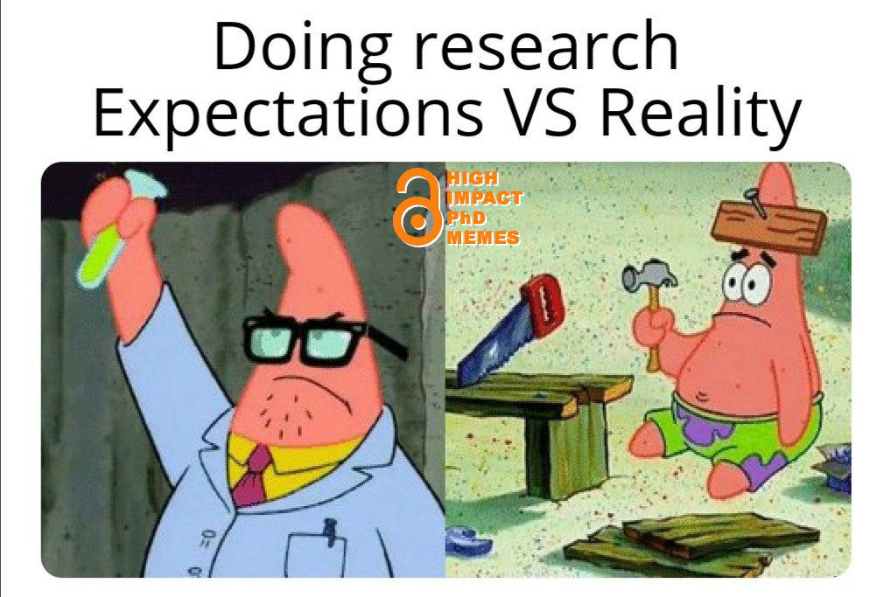
Science is suffering
Learning how to become a good scientist is something that cannot be learned in one day
  It takes blood, sweat, focus, and most importantly, experience
Teaching you everything you need to succeed in just one lecture would be very optimistic
  This does not mean that we can’t put
  a few aces up your sleeve!
  There are some tricks that you
  can learn to maximize you
  chances of success

Slide 77
Structure
Scientific papers have a pre-defined structure
  It may slightly vary according to your
If you cannot structure your work with the following
structure, there’s a good chance that something is wrong
with your experiment!
Different papers require different structure
  What sections would you use for a position paper?
  What structure would you use for a state-of-the-art
  paper?
If you were to write a paper today, could you fill all sections?
Introduction
Related work
Model
Proposed approach
Experimental results
Discussion
Conclusion
References

Slide 78
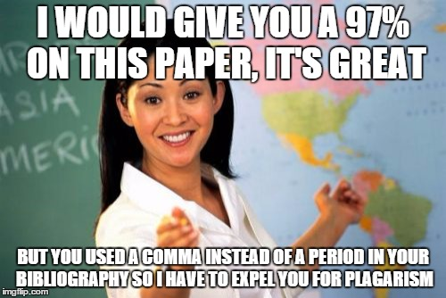
Reference style
There are over a dozen different reference styles, and each journal/conference will ask you to use a specific one
  The style differs both in terms of in-text referencing and bibliography referencing
Make sure to know the one you need
to use in advance
  If you are writing a 20 pages paper,
  you may have to change 80 references
  by hand within the text

Slide 79
Reference style - bibliography
My paper “Natural interaction in virtual reality for cultural heritage” (don’t read it, it’s boring):
MLA: Galdieri, Riccardo, and Marcello Carrozzino. "Natural interaction in virtual reality for cultural heritage." International Conference on VR Technologies in Cultural Heritage. Springer, Cham, 2018.
APA: Galdieri, R., & Carrozzino, M. (2018, May). Natural interaction in virtual reality for cultural heritage. In International Conference on VR Technologies in Cultural Heritage (pp. 122-131). Springer, Cham.
Chicago: Galdieri, Riccardo, and Marcello Carrozzino. "Natural interaction in virtual reality for cultural heritage." In International Conference on VR Technologies in Cultural Heritage, pp. 122-131. Springer, Cham, 2018.
Harvard: Galdieri, R. and Carrozzino, M., 2018, May. Natural interaction in virtual reality for cultural heritage. In International Conference on VR Technologies in Cultural Heritage (pp. 122-131). Springer, Cham.

Slide 80
Reference style – in text
MLA: using parenthetical citations. This method involves providing relevant source information in parentheses whenever a sentence uses a quotation or paraphrase.
  Es: «The source information required in a parenthetical citation depends (1) upon the source medium (e.g. print, web, DVD) and (2) upon the source’s entry on the Works Cited page»
APA: When using APA format, follow the author-date method of in-text citation. This means that the author's last name and the year of publication for the source should appear in the text
  Es: «Jones (1998) found that...» or «As previously demonstrated (Jones, 1998)»
Chicago: when referring to a source of information within the text of a document, in its simplest form, gives a short citation consisting of the name of the author (or authors) and the date of publication
  Es: “There are many reasons for intestinal scarring (Ogilvie 1998, 26-28)»
Harvard: Give the author’s surname followed by the date of publication in brackets.
  Es: «Mogra (2016) concludes that most trainee teachers surveyed wanted collective worship to continue»

Slide 81
Reference style - target
Different sources require different styles
  The way you quote a book is different from the way you quote a conference paper
  J. Williams, “Narrow-Band Analyzer,” PhD dissertation, Dept. of Electrical Eng., Harvard Univ., Cambridge, Mass., 1993. (Thesis or dissertation)
  S.P. Bingulac, “On the Compatibility of Adaptive Controllers,” Proc. Fourth Ann. Allerton Conf. Circuits and Systems Theory, pp. 8-16, 1994. (Conference proceedings)
  W.-K. Chen, Linear Networks and Systems. Belmont, Calif.: Wadsworth, pp. 123-135, 1993. (Book style)
  templates for all IEEE Computer Society journals.
Notes:
https://journals.ieeeauthorcenter.ieee.org/create-your-ieee-journal-article/authoring-tools-and-templates/ieee-article-templates/templates-for-computer-society-publications/

Slide 82
Common language mistakes
The language of science is Standard Academic English
Your English is already good enough for academic writing (or you wouldn’t be here), just keep a few things in mind while writing a paper:
Do not use contracted forms of ANY kind
  Don’t/can’t/wasn’t VS Do not, cannot, was not
Do not use first person unless it’s strictly necessary
We believed it to be the best solution VS It was believed to be the best solution
Notes:
https://journals.ieeeauthorcenter.ieee.org/create-your-ieee-journal-article/authoring-tools-and-templates/ieee-article-templates/templates-for-computer-society-publications/

Slide 83
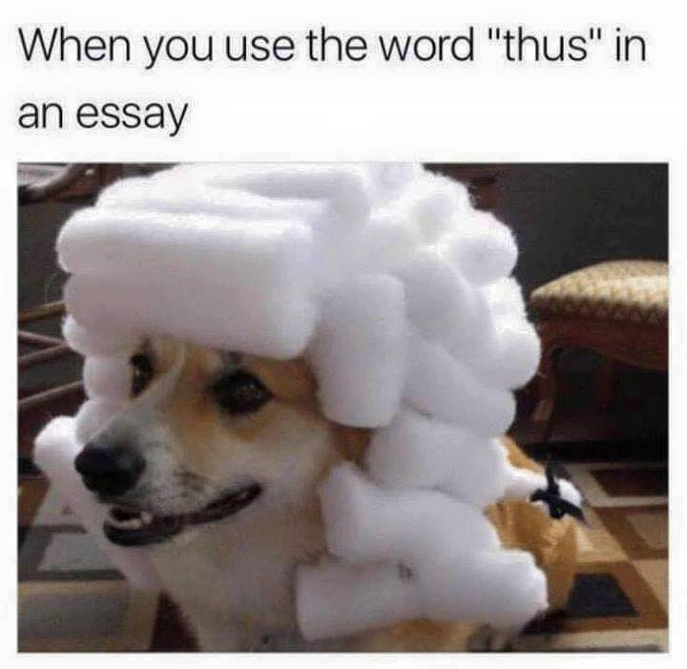
Common language mistakes
Do not use slang
  Kids/Bottom Line/KUDOS VS Children/The main point/respect
Do not use negatives
Is not effective/is not positive
Is ineffective/is negative
Avoid pronouns
As you can see from the graph
The graph shows
Avoid vague language
A bit of/a lot/kind of/sort of
quantifiable measurements!
Notes:
https://journals.ieeeauthorcenter.ieee.org/create-your-ieee-journal-article/authoring-tools-and-templates/ieee-article-templates/templates-for-computer-society-publications/

Slide 84
Commong Language mistakes
Especially in applied sciences, you are unlikely to find universal solutions
When pointing out limitations/drawbacks of other papers, don’t be too harsh or categorical. Be smooth and fair (authors can be reviewers)
  Lee et al. [13] proposed a method for saving energy in wireless networks, but their approach is very inefficient and cannot be used in practical systems with many nodes
  Lee et al. [13] proposed a method for saving energy inwireless networks, however their approach is only effectivefor relatively small networks
There are «safewords» you can use to make your statement less absolute:
  «Arguably», «suggests» (or even better «seems to suggest»), «it is reasonable to assume», and many others

Slide 85
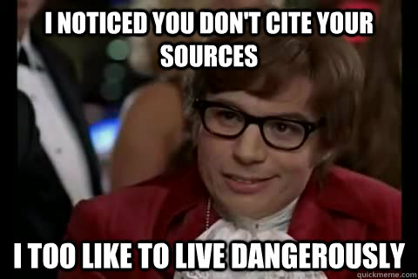
Cite your sources
Whenever you assert something, YOU NEED TO CITE YOUR SOURCE
It does not matter if it is a known fact or something that is considered common knowledge or irrelevant, YOU NEED TO CITE YOUR SOURCE
Universities have tools that can evaluate
the degree of similarity whenever you
submit a paper/assignment. If you state
something without quoting a source, your
similarity score raises, and if it gets over a
certain threshold you can be accused of
plagiarism. YOU NEED TO CITE YOUR SOURCE
YOU NEED TO CITE YOUR SOURCE

Slide 86
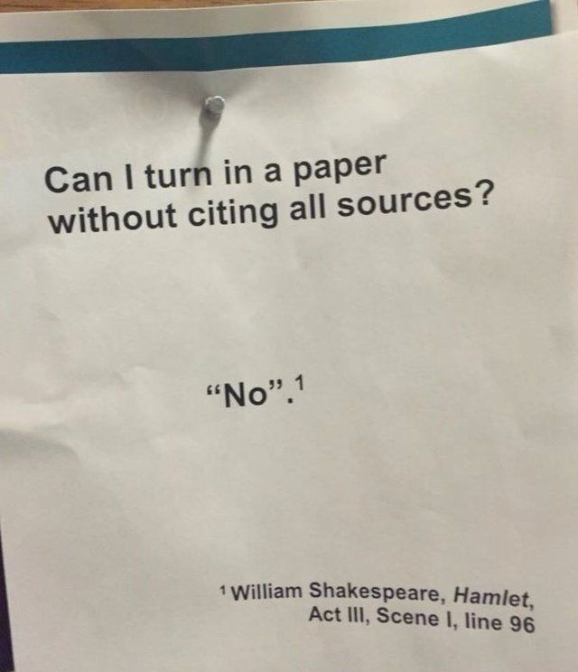
Cite your sources

Slide 87
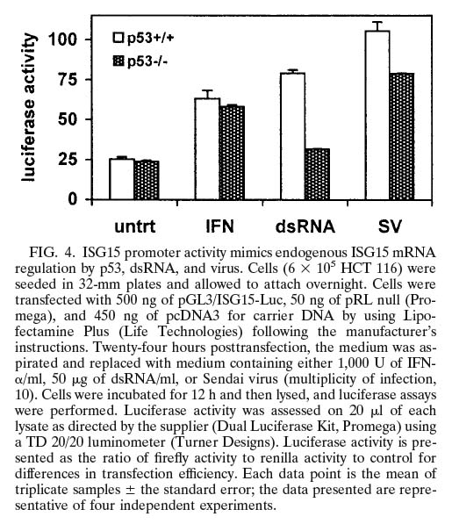
Graphs and Tables
No one likes walls of text
  Some papers ask you a minimum number of pictures or tables that have to be included in your max paper length
Your images should be:
  Big enough to be understandable
  Meaningful in terms of data
  Easy to understand
  2D
  Have only a few lines of explanation
    If it has more than 5-6 lines of explanation,
    consider moving it to the main corpus
Notes:
Hummer BT, Li XL, Hassel BA (2001) Role for p53 in gene induction by double-stranded RNA. J Virol 75:7774-7777, Figure 4

Slide 88
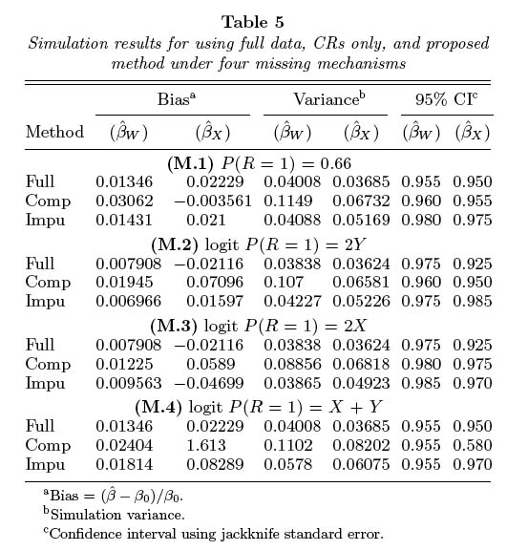
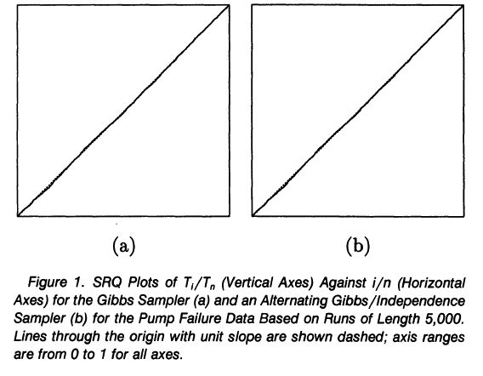
Graphs and Tables
Notes:
Paik MC (2004) Nonignorable missingness in matched case-control data analyses. Biometrics 60:306-314, Table 5
Mykland P, Tierney L, Yu B (1995) Regeneration in Markov chain samplers. Journal of the American Statistical Association 90:233-241, Figure 1

Slide 89
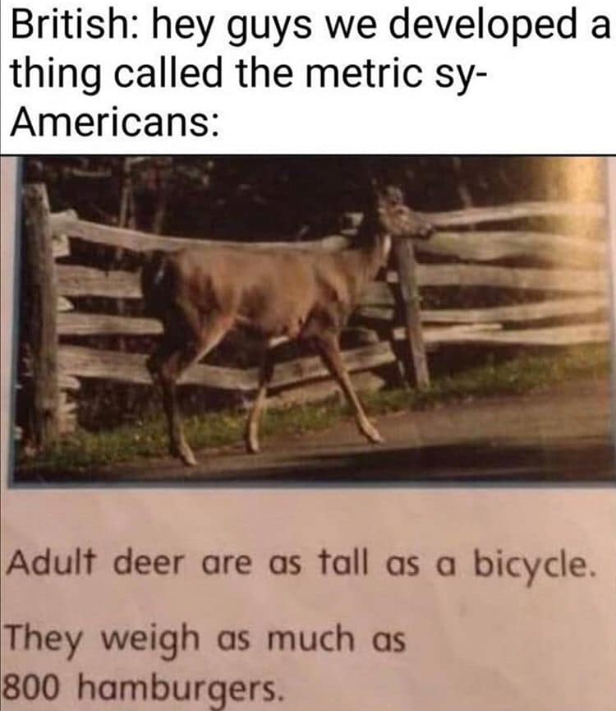
Standards
Always make sure to specify your unit in every graph or picture, but most importantly, make sure to use international standards!
If you don’t tell your units, people won’t be able to
understand your paper
  REJECTED!
Tragedies can happen if you misinterpret the data
  Air Canada Flight 143 (Gimli Glider)
  Mars Climate Orbiter
  Cristopher Columbus (yep, in 1492)
Notes:
Hummer BT, Li XL, Hassel BA (2001) Role for p53 in gene induction by double-stranded RNA. J Virol 75:7774-7777, Figure 4

Slide 90
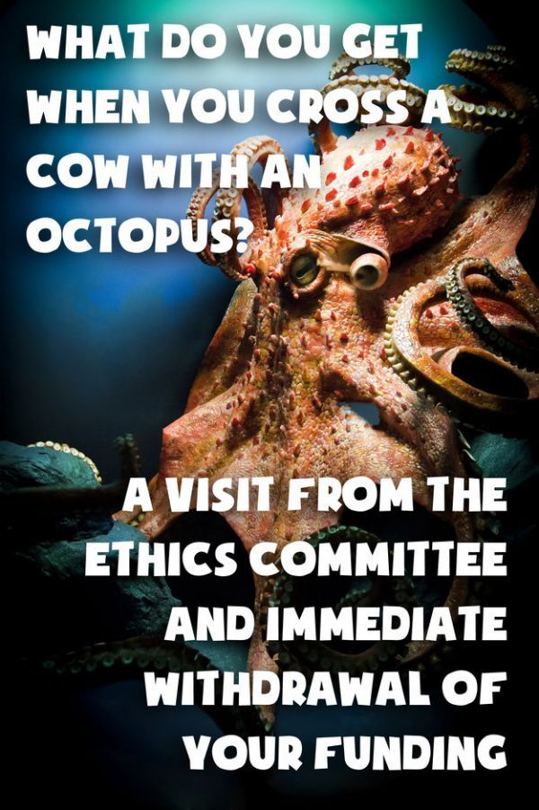
Ethics
«Ethics are a set of moral principles and values a civilized
society follows. Doing science with principles of ethics is
the bedrock of scientific activity»
Each university/lab/country has its own way to handle
ethical problems
  Most of them have a list of things that can and cannot
  be done, and an ethical committee to supervise all
  research groups
Are you working with kids? Do you need personal consent?
Does your institution believe that test subjects could be
harmed in any way? Are they aware of the process?
Notes:
https://www.ncbi.nlm.nih.gov/pmc/articles/PMC4456506/

Slide 91
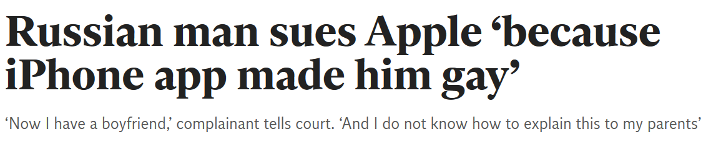
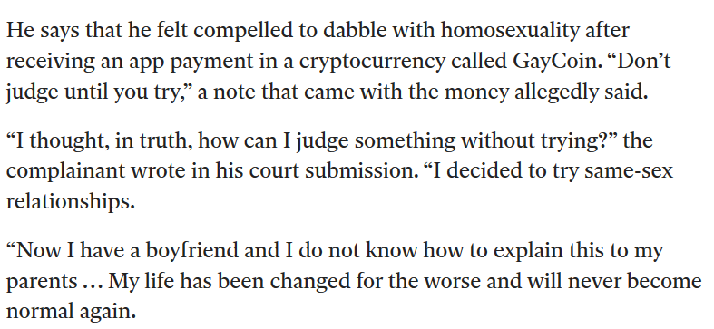
Ethics

Slide 92

Data Analysis
You must be able to matematically (statistically) justify every assumption you make on your data
If you are analysing data, there are certain statistical indexes that can make your assumptions stronger
  Other researchers will know how you
  calculated your indexes and it will
  be easier for them to undestand what
  is going on
A few examples:
  Standard Deviation, population sampling,
  generalization, correlation, regression analysis

Slide 93
Control groups
«A control group in a scientific experiment is a group separated from the rest of the experiment, where the independent variable being tested cannot influence the results. This isolates the independent variable's effects on the experiment and can help rule out alternative explanations of the experimental results.»
Control groups are a great way to generalise experiments that have been conducted with a sample that is not representative of a whole, larger population!
  You can also use control groups to validate your research against previous works and demonstrate that your method is in line with previous literature

Slide 94

Control groups

Slide 95

Biases
Biases are the CANCER of scientific research
The amount of literature that does not consider potential data contamination is depressing
Every time you do an experiment, you need to check for potential biases in EVERY part of it, from your data analysis, to your methodologies, to your questionnaires
You should ALWAYS make potential biases
explicit in your research

Slide 96

Implicit bias test
When you are working with test subjects, and you are asking them to rate something based on their experience, you should always ask them to take an implicit bias test!

Slide 97

Questionnaire biases
You can bias your experiment just by asking questions the wrong way
Sometimes people naturally tend to lie in questionnaires without even knowing it! (Response bias)
  Your presence could lead them to answer
  to please you or to minimise the risk
  of being judged because of the answer
Let’s see a few examples

Slide 98
Subjectivity
«Is your work made more difficult because you are expecting a baby?»
This question is ambiguous. A "no" answer may mean, "No, I'm not expecting a baby," or "No, my work is not made more difficult"
«How often do you exercise?»
Regularly or occasionally are subjective, twice a week or more often, once a week, less than once a week are not
«Do you do physical exercise, such as cycling?»
This is a leading question because it will likely lead the respondent to focus only on cycling

Slide 99
Subjectivity
«Don't you agree that . . . ?»
This negatively worded question leads respondents to answer no. The preferred phrasing is «Rate your level of agreement on...»
«Did you enjoy....»
The emphasis on enjoyment is too strong and could lead people to response with a higher score
Unless you can prove that your questionnaire is unbiased, rely on standard ones!

Slide 100
Article retraction
Even with all the procedures in place, errors can happen
  An article that is proven to be faulty can either be corrected or retracted
There are many reasons for an article to retracted:
  Non-standard methodology
  Data has been somehow tampered
  Experiment cannot be reproduced
  It contains the same information of another published article
  Ethically wrong
When an article is retracted, it is no longer considered a valid source of knowledge, and cannot be cited

Slide 101
Articles retraction for error
2012 - Article suggesting reported an increase in tumors among rats fed genetically modified corn and the herbicide RoundUp retracted due to criticism of experimental design. According to the editor of the journal, a «more in-depth look at the raw data revealed that no definitive conclusions can be reached with this small sample size»
2003 - Severe dopaminergic neurotoxicity in primates after a common recreational dose regimen of MDMA was a paper by Dr. George Ricaurte which was published in the leading journal Science, and later retracted. The reason was that instead of using MDMA, methamphetamine had been used in the test.

Slide 102
Articles retraction for fraud
2017 - 5 articles by Brian Wansink came under scrutiny in the field of consumer behavior after peers pointed out inconsistencies in data in papers after Wansink had written a blog post about asking a graduate student to "salvage" conclusions. In 2018 he was found by a University investigatory committee to have committed academic misconduct and resigned. Wansink has since had 18 of his research papers retracted as similar issues were found in other publications.
2009 - Numerous papers written by Scott Reuben from 1996 to 2009 were retracted after it was discovered he never actually conducted any of the trials he claimed to have run.

Slide 103
Articles retraction for fraud
The Lancet has retracted the 12 year old paper that sparked an international crisis of confidence in the safety of the measles, mumps, and rubella (MMR) vaccine when its lead author suggested a link between the vaccine and autism. Andrew Wakefield was found guilty by the General Medical Council last week of dishonesty and flouting ethics protocols.

Slide 104

Article retraction
Hopefully this will never happen to you

Slide 105
Section 4: Conclusions!
“The most exciting phrase to hear in science, the one that heralds new discoveries, is not ‘eureka’, but ‘that’s funny...’” – Isaac Asimov

Slide 106

Conclusions
Science is hard....
  ...but it can also be extremely rewarding
Find the research question that helps you get out of bed in the morning, crave for the answer, and make this world a bit better by working with hundreds of people around the world
There is no better sensation that meeting
someone who says “I have read your work,
it was enlightening and I have used on my
research too”

Slide 107





Conclusions

Slide 108


