Slide 1


From zero to hero
How to prototype in less than a Jam time!
Speaker: Riccardo Galdieri
Notes:
If I am too serious you all fall asleep
Science is fun, why make it sound boring?

Slide 2


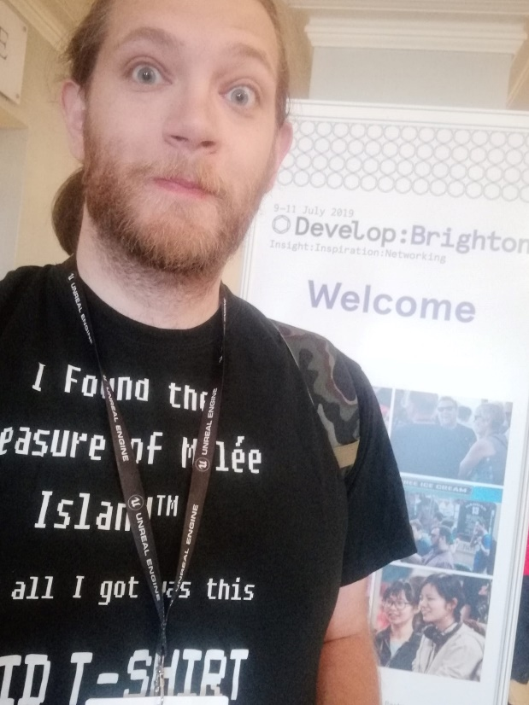
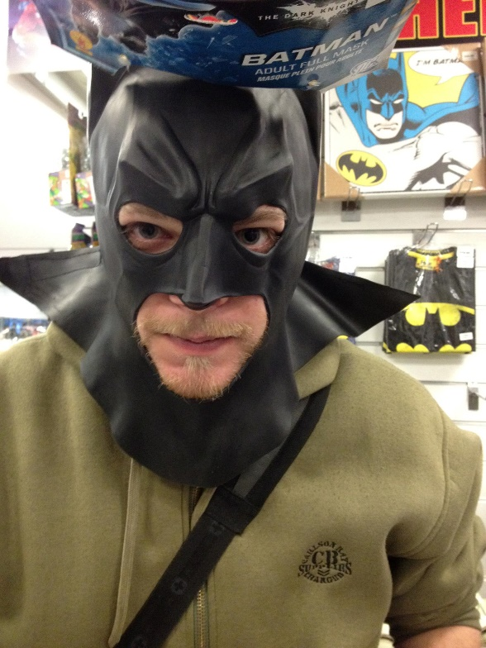
Who am I?

Slide 3

About me
3rd year PhD Student in Emerging Digital Technologies at Scuola Superiore Sant’Anna (Pisa, Italy) – Visiting Staff at BUas (Before the world almost ended)
Currently working on understanding how players interact with virtual environments. This means we’re trying to catalogue:
  Players’ subconscious behaviours
  Previous knowledge influence
  Importance of environmental factors and UI
  Players’ relationship with controllers
  How people with disability understand virtual worlds

Slide 4
About me
Bachelor Degree in Digital Humanities
  Thesis on using Markov Chains to perform authorship attribution on fictional characters
Master Degree in Digital Humanities
  Thesis on developing tools to improve museum exhibitions design (huge disappointment)
Study abroad experiences:
  King’s College London (2012-2013)
  National Taiwan University (2014-2015)

Slide 5
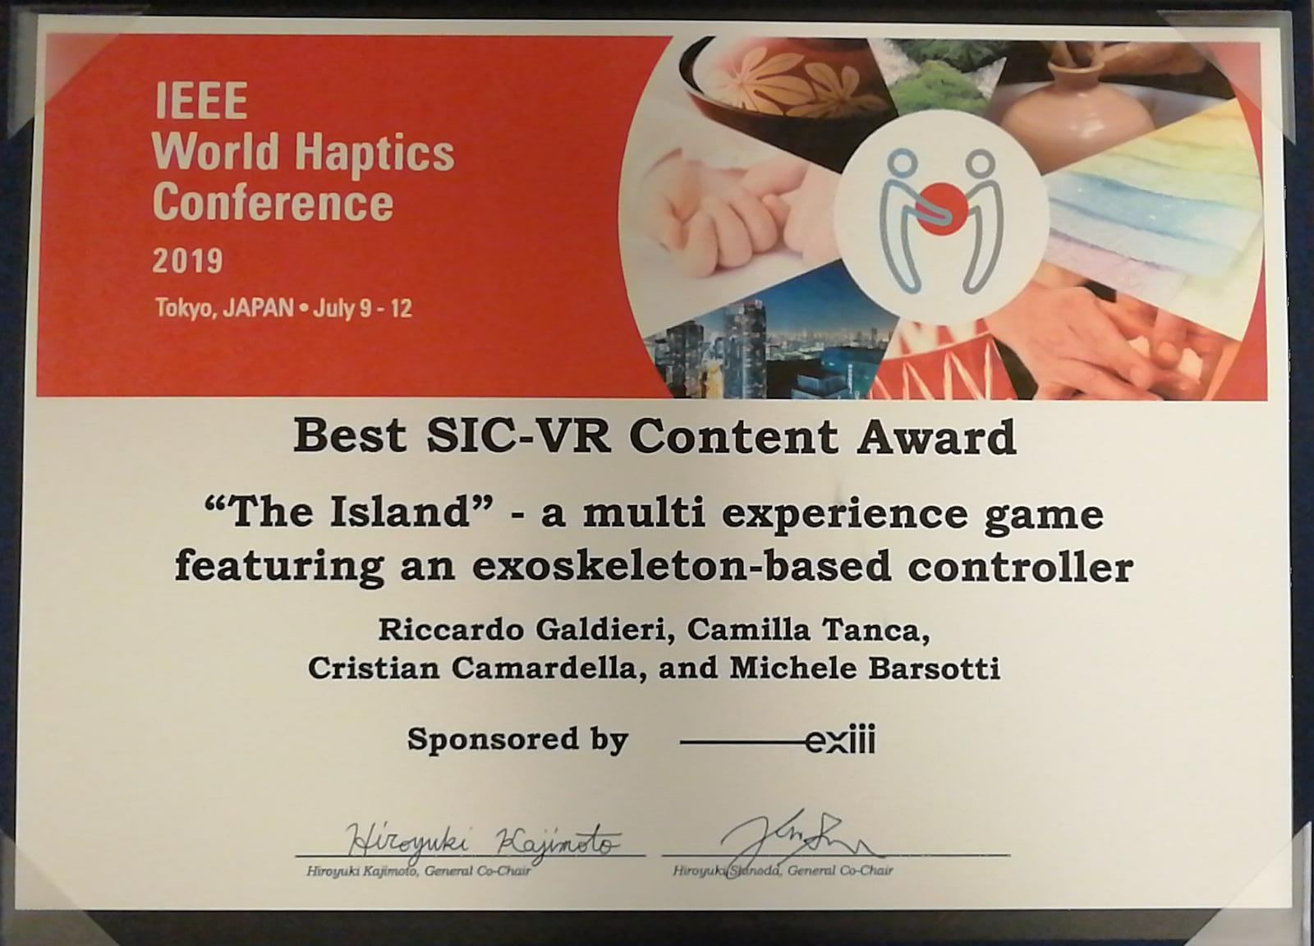
About me
VR «expert» (or whatever that means)
Other research interests: Human-computer interaction, interaction metaphors in immersive virtual environments (VR), digital cultural heritage

Slide 6
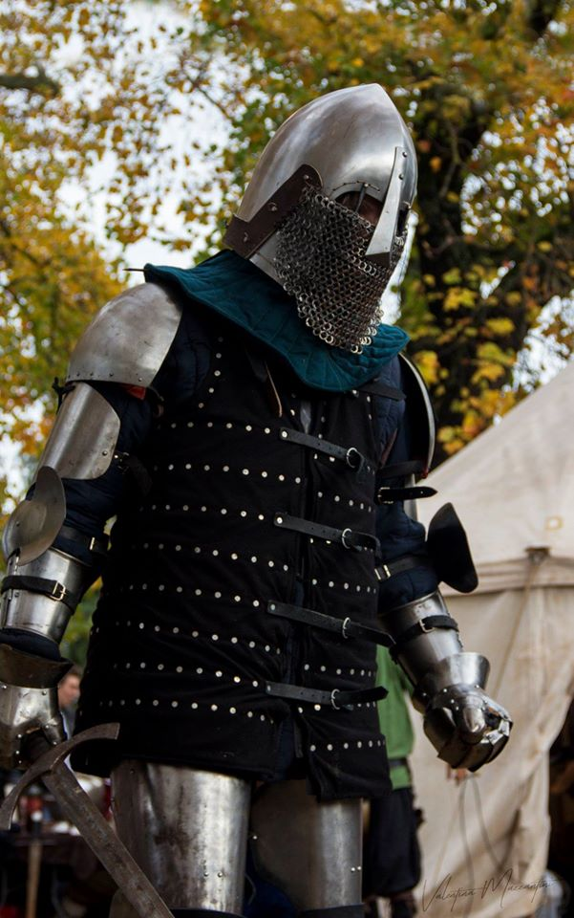
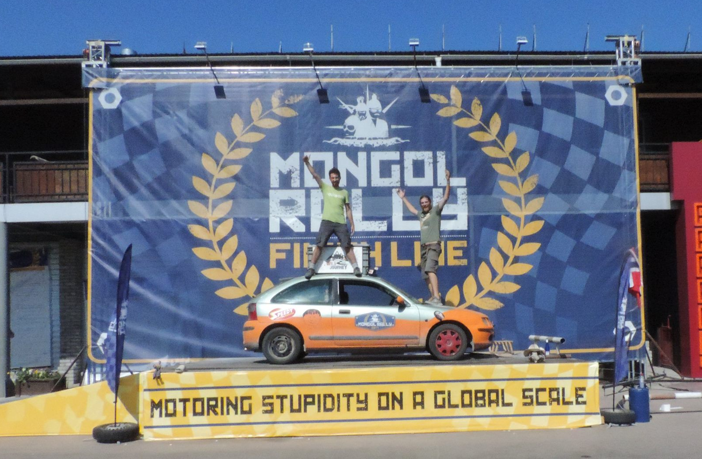
About me
Experienced Jam Veteran, Mongol Rally Veteran, former semi-pro fighter
Notes:
Matt Might is Professor of Internal Medicine and Computer Science
http://matt.might.net/articles/how-to-apply-and-get-in-to-graduate-school-in-science-mathematics-engineering-or-computer-science/

Slide 7
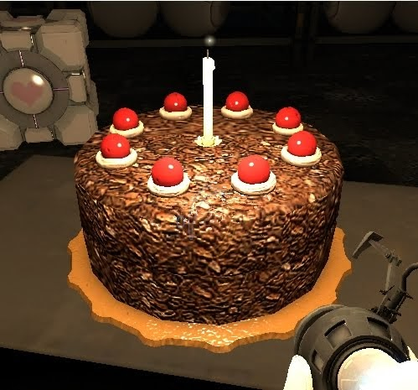
On today’s menu
Appetizers:
What is a game Jam
First course:
What is a Game Jam (and what isn’t)
Why you should attend a Game Jam
Second course:
Practical suggestions
Do’s and Don’t’s
Cake!

Slide 8
How to take this webinar
I am not a professor. Please, PLEASE, feel free to interact with me and ask any question, I’m here to share my experience, not to cast universal truths
There are some useful links in the notes attached to this presentation, I’ll make sure they’ll be shared with you!
The slides will be available at some point on my website
  riccardogaldieri.com/teaching
If you feel like reaching me out for any reason, drop me a message!
  riccardo.galdieri@santannapisa.it

Slide 9
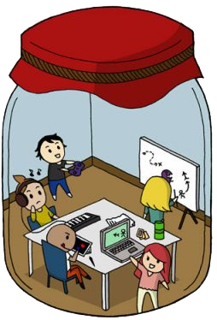
What is a Game Jam?

Slide 10
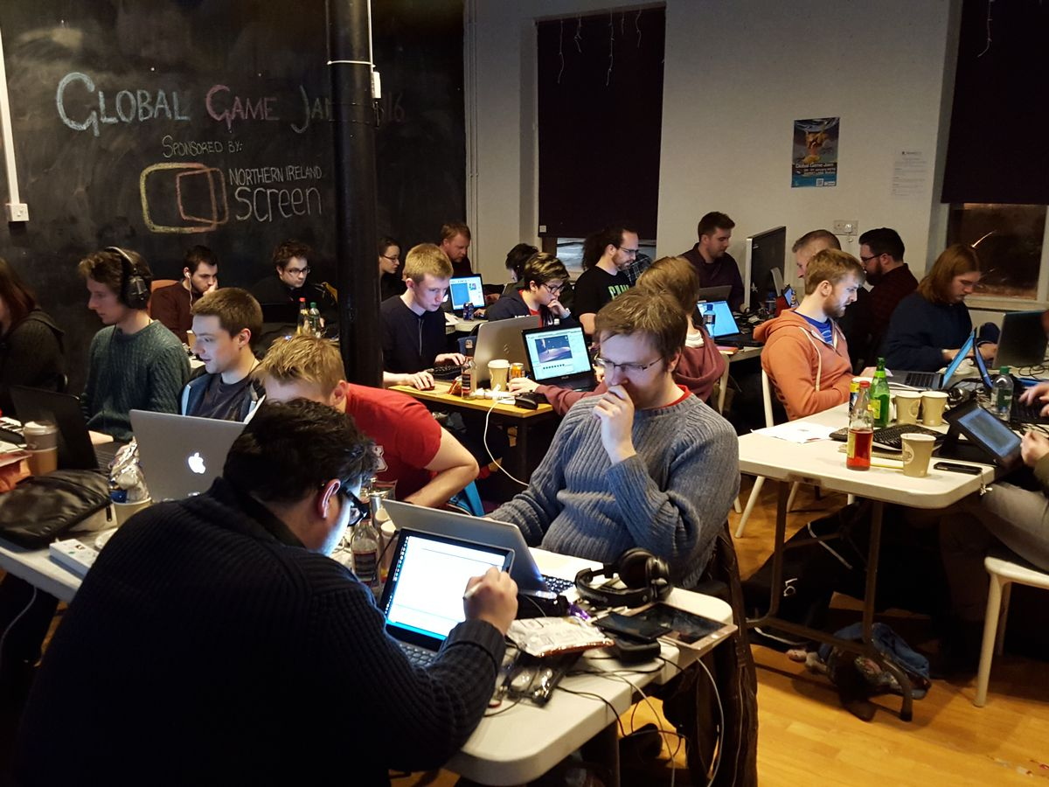
What is a Game Jam
“A Game Jam is an event where the attenders have to build a game in a fixed amount of time”
It takes its name from Jam sessions, popular
music events where musicians get
together to play without any previous plan
  During a game jam, you shouldn’t have
  a plan either!
The primary goal of any jam is
to be creative, together
Notes:
Ask how many people have attended a jam before

Slide 11
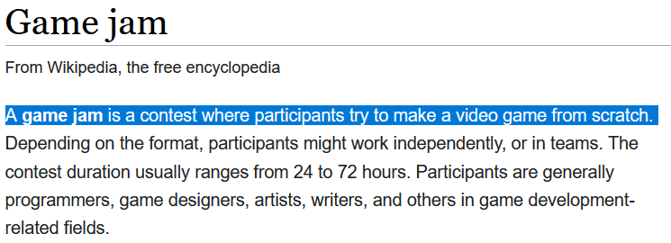
What can you make during a Jam
There is a misconception that Game Jams are about videogames, but that’s not true!
  Even Wikipedia’s definition is wrong
Games can be of many types:
  Board Games
  Videogames (Apps/PC/VR/AR)
  Social Games
  Interactive stories
  Hardware

Slide 12
The theme
Game jams rotate around one theme, that can be either domain specific
or generic
  Automotive/industrialization/environment based jams
  Game jams
  Hackatons
Usually the main theme is known in advance when the jam is “themed”, or known before the jam starts
Themes should not be interpreted literal, they are more of a suggestion to help you be creative!
  More about this later

Slide 13
What should you make during a jam
A Jam is the best place to get ideas
No one is expecting you to make a full product during the jam!
You will make a prototype, a proof of concept
  Best case scenario you will develop this game further and create a real game
  Worst case scenario you put yourself out of your comfort zone, learned something new, and had a lot of fun!
If your idea is valid, you will develop it AFTER the jam!

Slide 14
Most common Game Jams
Global Game Jam
  All over the world! Common theme revealed on the spot
Ludum Dare
  2 times per year, theme revealed on the spot
Train Jam
  52 hours, participants are stuck on a train from Chicago to San Francisco before the GDC
For you: Transylvania Game Jam!

Slide 15
Famous games coming from a jam
SUPERHOT (3+ Million $)
Surgeon Simulator (6+ Million $)
Keep Talking and Nobody Explodes (2+ Million $)
And many others:
  ONS (One Night Stand)
  Celeste
  AVGM (Abusive Video Game Manipulation)
  Goat Simulator
  Gods Will be Watching

Slide 16
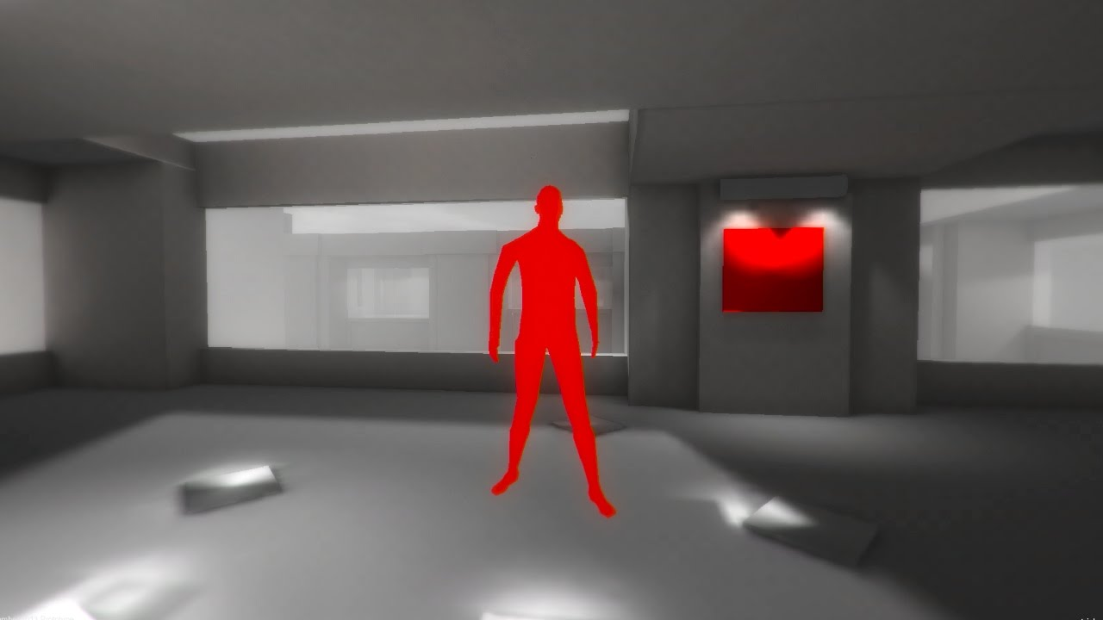
Famous games coming from a jam

Slide 17
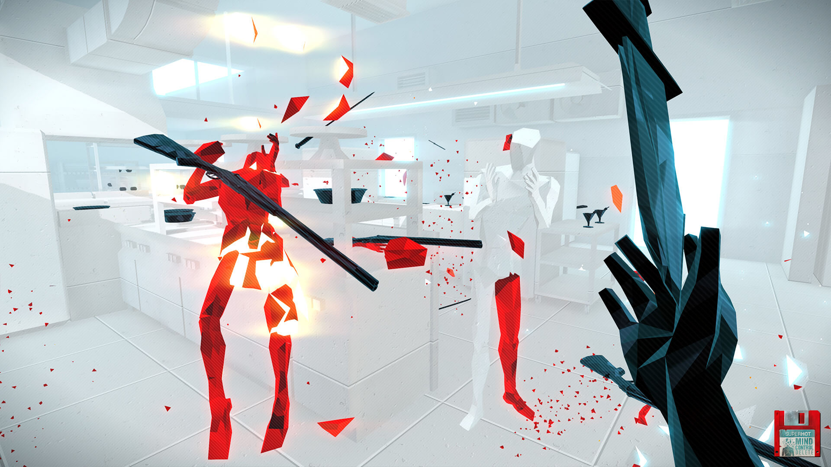
Famous games coming from a jam

Slide 18
From Zero to Hero

Slide 19
The phases of the Jam
Game Jams can be divided into roughly 10 phases
  Preparation and registration
  Theme revelation
  Team making
  Logistics
  Brainstorming
  Eating/developing/sleeping/testing x3/4/5/6 times (development)
  Share
  Deployment
  Celebration
  Sleep

Slide 20
Phase 1 – Preparation and registration
This phase starts DAYS before the jam, make sure to give yourself time to think about these things
Most jams have (free) tickets, make sure to reserve yours!
  You will probably have to register on site as well, and hopefully receive some goodies!
You rarely know where you’ll jam from, make sure to have ALL the tools you need with you before getting there!
  Do you have a laptop or a desktop? How are you going to connect to the internet? Do you need some specific hardware with you? Do you have enough food/water? What about plug adapters? And a sleeping bag?

Slide 21
Phase 1 – Preparation and registration
Make sure to have all the software/hardware with you!
Internet is a commodity during Jams, make sure to have basic software such as:
  Blender/Maya
  Unity/Unreal/GameMaker/RPGMaker
  Photoshop/Gimp/CrazyBump/AwesomeBump
  Marmoset/Substance Painter
  GitHub/GitKraken
There is PLENTY of useful repos of data you can freely download prior to the jam
  Link on the last slide
Notes:
Go through some of these softwares

Slide 22
Phase 2 – Theme revelation
The revelation is one of the most anticipated moment of many Jams, embrace and enjoy it!
If the Jam is not bound to a physical location, it may be revealed at different times all over the world!
  Make sure to respect all the rules you’re given!
A few (real) examples (From GGJ):
  "As long as we have each other, we will never run out of problems", "Deception", "Extinction", “An image of "Ouroboros", “The Sound of a Heartbeat, "We don't see things as they are, we see them as we are", "What do we do now?", "Ritual", Waves", Transmission", “What home means to you", “Repair"

Slide 23


Slide 24
Phase 3 – Team making
DO NOT MAKE A TEAM WITH PEOPLE YOU ALREADY WORK WITH!!!

Slide 25
Phase 3 – Team making
DO NOT MAKE A TEAM WITH PEOPLE YOU ALREADY WORK WITH!
Get to the venue in advance, get the chance to meet other people, be friendly and get to know everyone!
The team are VERY flexible, the fact that you are part of one group does not mean you can’t help another one!
  (There are always too many programmers and not enough artists/musicians)
….why don’t you make random teams?
Notes:
If you have already a relationship with the people you’re working with, there’s a chance you already have shared thoughs. Brainstorming becomes harder, you don’t get out of your comfort zone

Slide 26
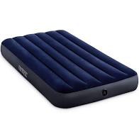
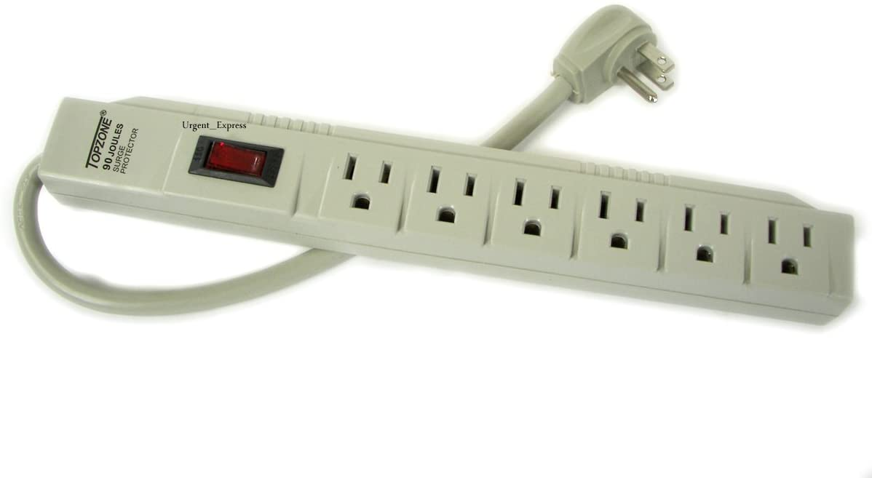
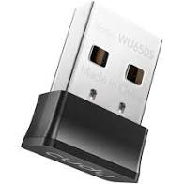
Phase 4 – Logistics
Do not underestimate the power of logistics!
Depending on the venue, there may be very few seats, not enough plugs, not enough tables, no internet, and any other problem you may (not) think of!
Be smart, and plan in advance!

Slide 27
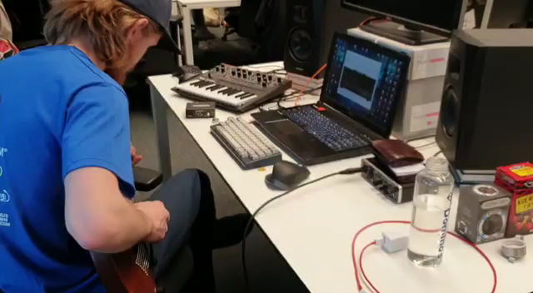
Phase 4 – Logistics

Slide 28
Phase 5 – Brainstorming
Finally, it’s time to get practical! But….. How?
Before building anything, you need to have an idea!
Ideally, before you even turn your laptops on, you should be able to answer these questions:
  What is your vision of the theme?
  What are you trying to achieve/What problem are you solving?
  Is your interpretation of the theme literal?
  What is the final product you are trying to make?
  Do you have a specific audience in mind?
Do not underestimate this phase! Take all the time you need
Notes:
Move forward ONLY if you have a plan!
The specific audience thing is important. Are they trying to build something for an audience? For disabled people? And so on…

Slide 29
Phase 5 – Brainstorming
Getting an idea sounds easier than it is.
  You can get stuck without anything meaningful for hours, and the time flies by
Luckily, even brainstorming can be turned into a game, and be a fun part of the game Jam!
There are several techniques that you can use:
  Brainwriting
  Round-robin brainstorming
  Mind mapping
  User Generated Stories

Slide 30
User Generated Stories!
A brainstorming methods we developed at the Breda University of Applied Sciences
Based on your previous knowledege.
  Starts with a high degree of comfort and decreases over time
You only need a pen and some pieces of paper!
It’s a social activity, and helps you to know your teammates!
Takes around 30 minutes

Slide 31
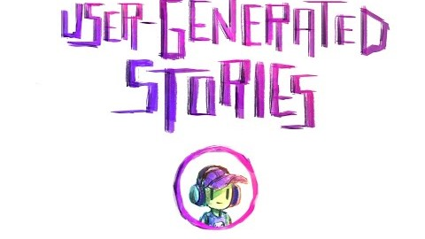
User Generated Stories!

Slide 32
Phase 5 – Brainstorming
Just remember: ideas are NOT set in stone
Experiment, break stuff, change plan, find what works and what not…
… But also make sure that everyone is on the same page!
Let’s make a little experiment
Notes:
The experiment is about being on the same page

Slide 33
Phase 5 – Brainstorming
Imagine a…….
  tall, male, muscled, bearded character, with tattoos
Notes:
Give them 10 seconds

Slide 34

Phase 5 – Brainstorming
Imagine a…….
  tall, male, muscled, bearded character, with tattoos

Slide 35
Phase 6 – Development
KEEP IT SMALL!
You need to build something that works within the given time frame, therefore:
  Code/Create for functionality, not to build a codebase/something maintainable
  Keep things simple
  Coordinate
When in doubt, ask someone for help
  Local Jammers
  Discord
  Google
Notes:
On the keep things simple: graphics, particles, tens of thousands of enemies, animations, and so on. Also, unless mechanics are simple, do not make too many levels!
Having meetings is helpful, but they have to be useful!

Slide 36
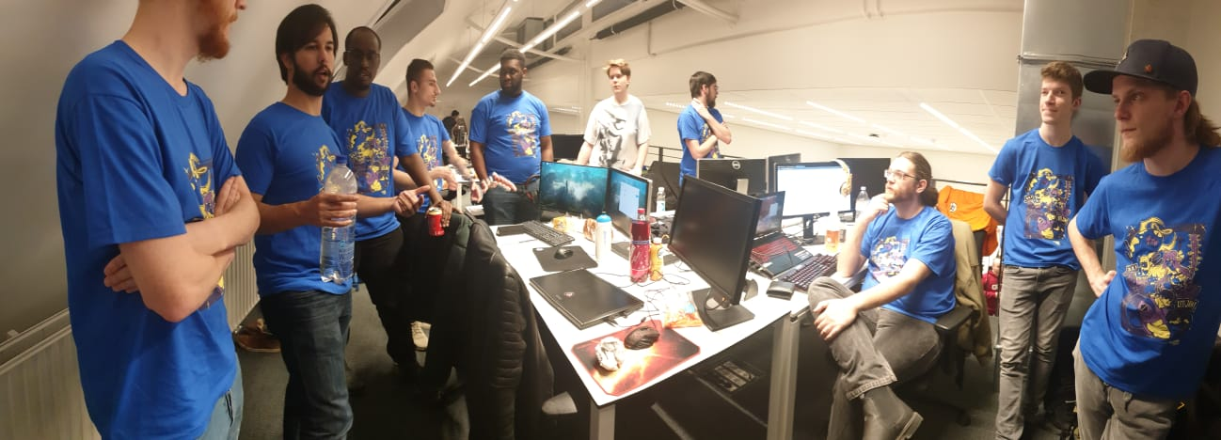
Phase 6 – Development

Slide 37
Phase 6 – Development (videogame)
Test it from the first phase on
  If the game is platform-bound, test it in deployment all the time
Do not refactor the code unless it’s necessary to add functionalities
Do version control as much as possible, but with care
Use the Pomodoro Technique
Sleep!!
Notes:
Version control is a nightmare, you’re tired and you’re overwriting stuff all the damn time

Slide 38
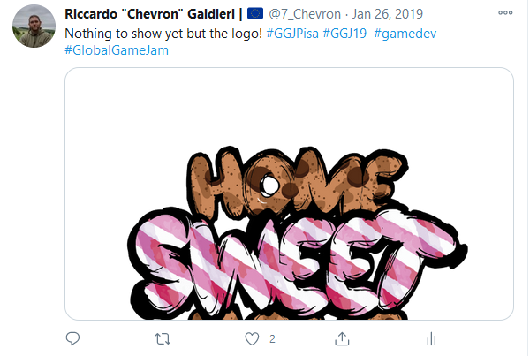
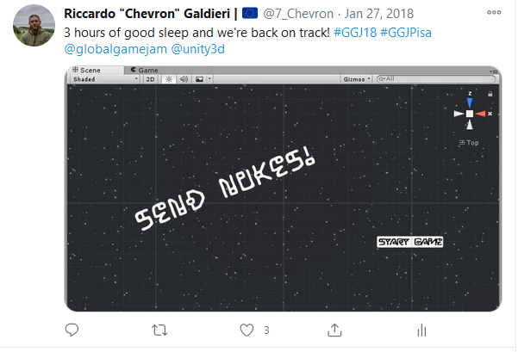
Phase 7 – Share
Share your game BEFORE the jam is over
Have a regular meeting with them and exchange builds/advices
Share your game on social media
  Every event has its own tag on Instagram/Twitter, make sure to use it

Slide 39
Phase 8 – Deployment
After the Jam, you should upload the final version of your project somewhere
Most Jams offer a dedicated page on their websites
If the jam is digital, only one person per team has to upload the build
Sponsors may be looking, show enthusiasm!
Many sites have a showcase after the deadline, where all teams present their game!
  It is extremely fun to see what other people ended up doing
  It often leads to new ideas!
Notes:
If the jam is themed, chance is, there are sponsors. Make sure to look happy and enthusiast, that’s what hits them the most

Slide 40
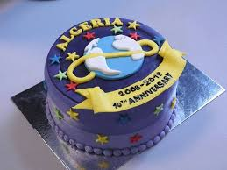
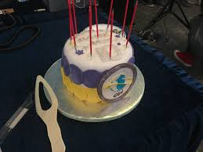
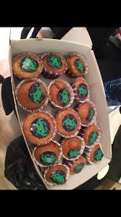
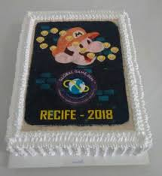
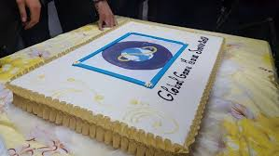
Phase 9 – Celebrate
Jams are, after all, a way to be together and meet new friends
Make sure to take enough time to close your laptop and give real people enough of your time

Slide 41
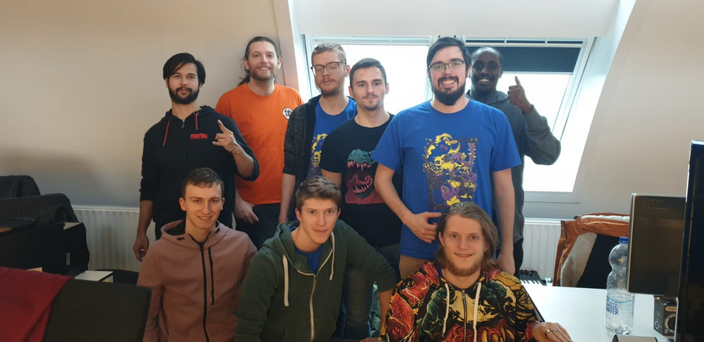
Phase 9 – Celebrate
Don’t forget to take a picture all together!

Slide 42
Phase 10 – Sleep!
Game jams are quite intense and, despite your best efforts, you won’t sleep much
Adrenaline will be your best friend, but when it disappears, so do you
  Do not drive to the Jam unless you can safely get back home within a few minutes!
Jams often end on Sunday, don’t go to bed too early!
  If you fall asleep at 4PM, chance is you will wake up somewhere in the middle of the night and screw your sleeping cycle
Notes:
I told you it was practical, doesn’t get any more practical than this!

Slide 43
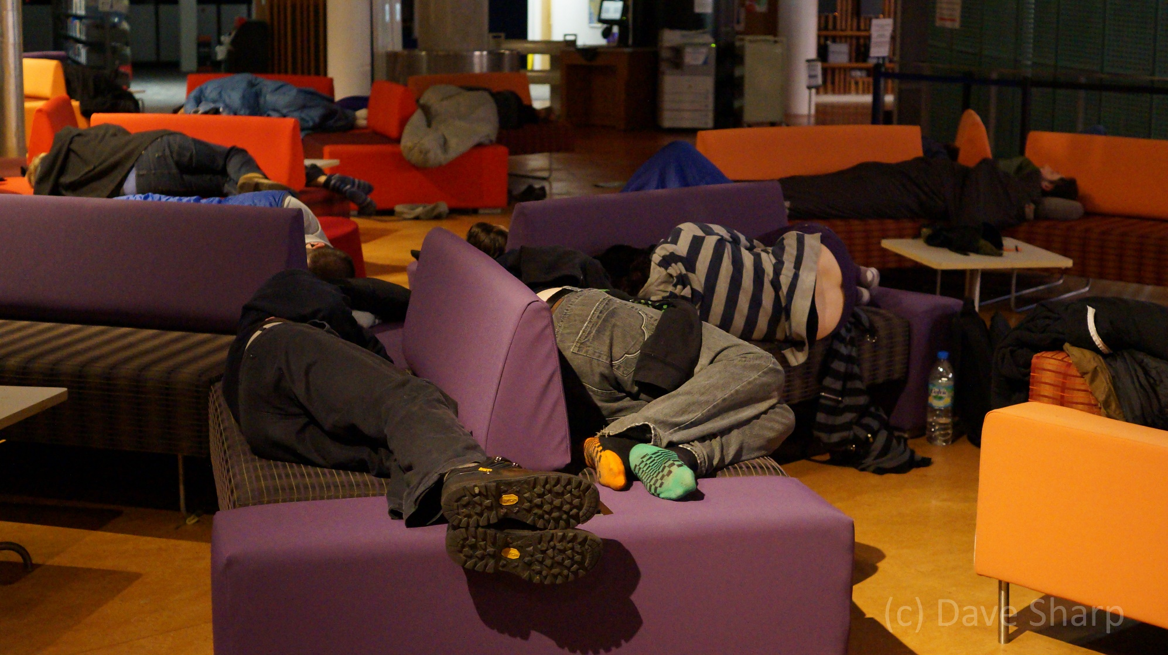
Phase 10 – Sleep!
Notes:
This is as much sleep as you’ll get

Slide 44
Dos and don’ts
Notes:
AKA: How to survive the jam

Slide 45
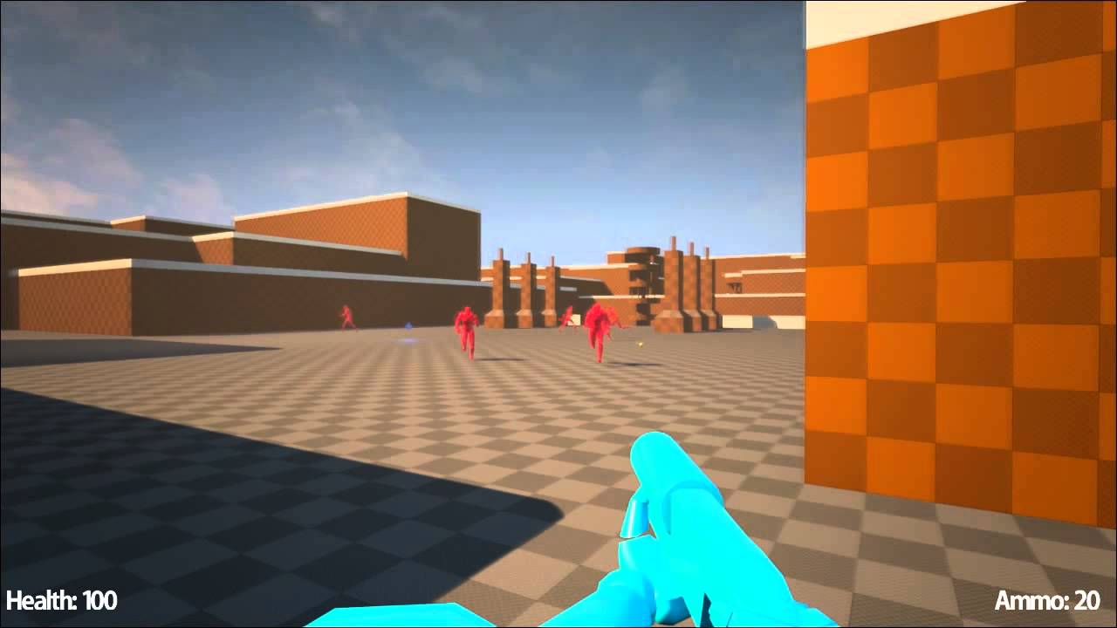
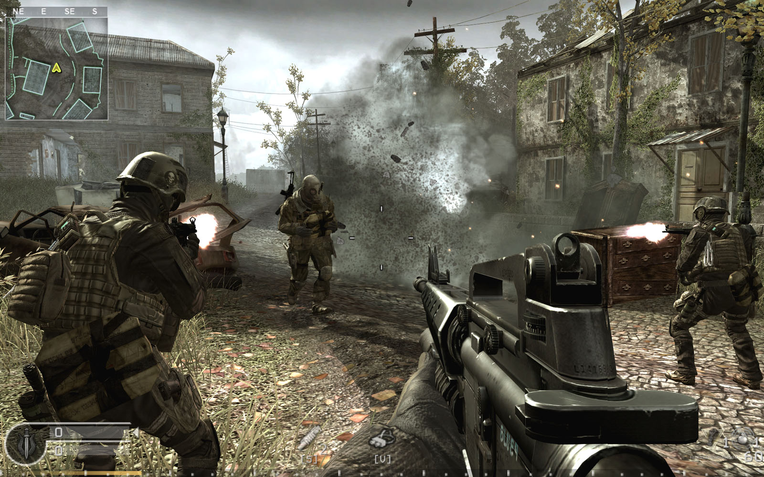
Ambitions and expectations
The amount of time you have is FIXED
Don’t overshoot
  Remember, you’re working on an Idea, not a product
Notes:
We have already seen SUPERHOT by this point

Slide 46
Get out of your comfort zone
Don’t do anything you alraedy have done in the past
Game jams are about being CREATIVE, not about being the best
Be propositive, but accept other people’s views. They’ll lead you to unknown places!
  Never used Unreal? Improvise!
  Never made a board game? That’s your chance
  Never done multiplayer? Go ahead!
It’s not important if it works or not after all...
Notes:
Game Jams are the only place where you’re encouraged to create and do mistakes without any consequence. Take the chance, go for it!

Slide 47
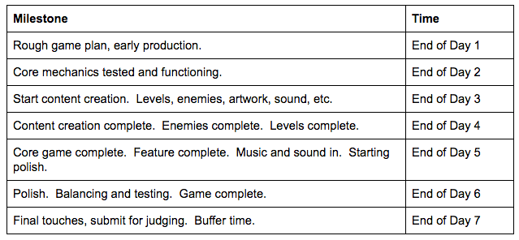
Make a plan!
The bigger the jam is, the more important it becomes to plan in advance
Notes:
Source: https://www.gamasutra.com/blogs/JohnCooney/20160706/276168/7_Tips_to_7Day_Game_Jams.php

Slide 48
Think out of the box
Themes are there to spark an idea, they are not assignments
  Do not take the themes literally!
Let’s see a few examples!

Slide 49
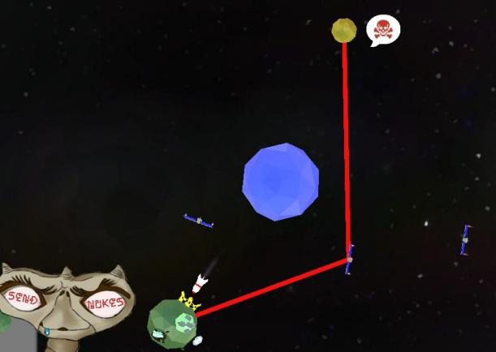
Theme: transmission

Slide 50
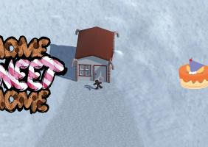
Home is where your heart belongs

Slide 51
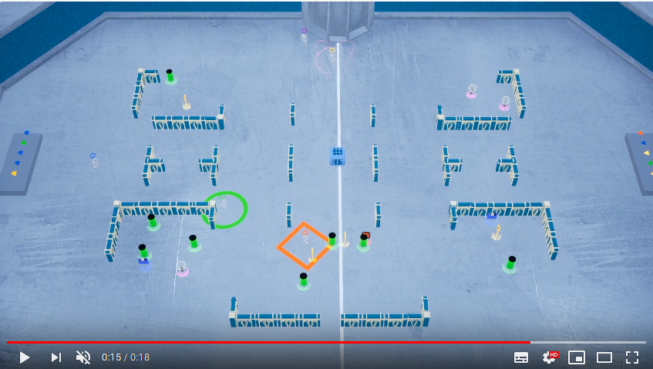
Repair
Notes:
We interpreted it as re-pair

Slide 52
Give yourself a goal!
Building something is fun, but you should always give yourself and the team a (shared) goal
  A skill to learn
  Improve some state of the art
  Define a new technology
Jams are the perfect place to experiment

Slide 53
Be mindful
Game Jams are big events, many people with different backgrounds will attend them
  It the jam is global, you are sharing stage with people all over the world
Be respectful of other cultures, other ideas, other points of view
Unless you’re trying to cast lights on a problem, avoid topics such as:
  Politics
  Specific diseases
  War
  Religion
To put it simple, don’t be a dick
Notes:
Even colors are political (red in Europe and USA). There’s a limit to that

Slide 54
Diversifiers
Some Jams, like the GGJ, already provide list of challenges that you can take part in
These are called Diversifiers, and are made public a few days before the event, so that people can give them a look
Final products use diversifiers as tags, making them easier to be navigated and found after the jam!
  Many streamers love to go through jams’ products and play these games!
You could start building your own product around one or more diversifiers!

Slide 55
Diversifiers
A few examples from previous years:
Power of Community - Make a game where community impacts your game. Players, viewers or streamers can enhance the game, change the outcome, or be a unifying force
Always Room for One More - Make a game where new players can join at any time.
Language-Independence - Create a game that can be understood regardless of which language the player speaks
Let me show you how it's done! - Make a game that is accessible to or represents your own disability, or that of a member of your team, in the way you feel all games should address it
In Ink - Use only black and white colors in your design. There should be no other colors, not even grey
Scale With A Song - Your game must last exactly the length of a single music track
Assetless - Create all visuals programmatically or in the scene editor, and avoid any importing of image files, sprite sheets, 3D models etc
Bolter is jammed! - Make a game where the main action is obviously missing. (platforming game with no jump, shooter without weapons, etc.)
Wanderlust - Your game tries to awaken interest in travel and visiting new places, with a focus on your home town
Recycle! - Instead of making a brand new game, start from an existing GGJ game from a previous year, made by someone you don’t know. Improve it and take it in a new direction.
Notes:
These are like steam achievements!

Slide 56
Health and safety
It is fundamental to keep yourself fed and awake during the jam
Make sure to eat HEALTHY food!
  It is not only good for your health, but can massively improve your focus!
Is your location offering you snacks/meals? Can you get back inside the building at any time and go out to grab food?
Using caffeine is good, using too much caffeine is bad!
  Caffeine provides a boost in focus, but it lasts approximately two hours, then you pay for
  Drink tea instead!

Slide 57
Health and safety
If the jam is over 24 hours, it is MANDATORY to sleep
Most jams have designated areas where you can put a sleeping bag
  They’re going to be crowded and noisy, you may prefer a couch or… your own desk
If you live close to the venue, you can go home, sleep a few hours, and come back
  Adrenaline will make sure you don’t oversleep
Bring earplugs. Jams are loud places, even at night

Slide 58
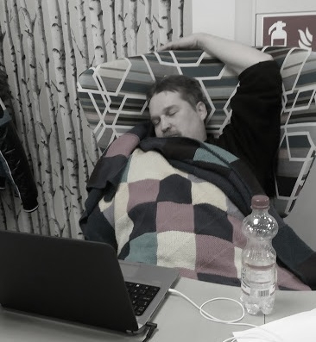

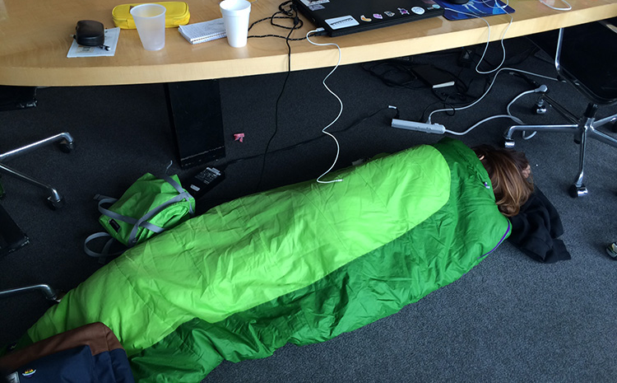

Slide 59
Take your time
Jams are time-related, but you don’t have to work 24h per day
Take your head off the project, have a walk, talk to other people
You have computers, play a game together!
Meditate
  If you’ve never done that, download headspace on your phone, that’s a life saver!
Notes:
Bodies are machines, after all

Slide 60
Equipment
Always remember to bring the equipment you think you may need
If you plan to make a hardware-bound project, remember that you will not likely work alone!
  For example, if you want to make a VR game, you need everyone to be able to access the game and test it out!
Think about the others too

Slide 61
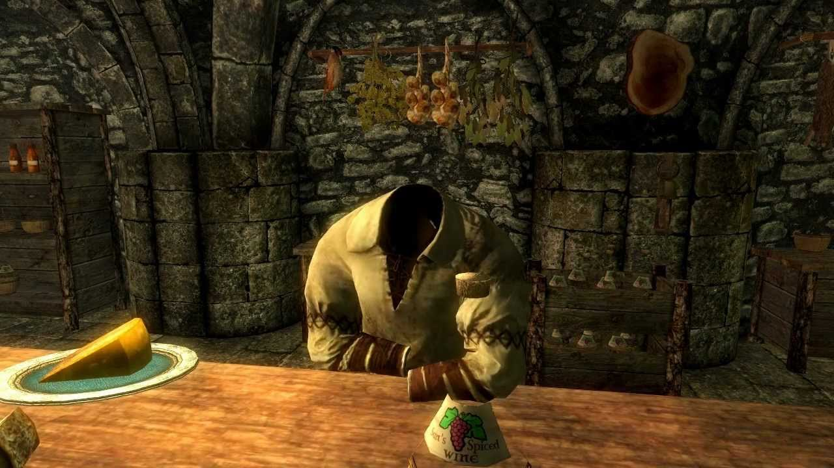
Embrace failure
It doesn’t matter how good you are. If you are doing things right, the game will not be perfect
A broken game with a great idea is better than a clone that works!
Failure isn’t the end of the world, wasting
opportunities is
Some bugs can be EXTREMELY funny
anyways
Notes:
If the game is perfect, you haven’t experimented
These are general advices

Slide 62
Useful links
User Genrated Stories
  https://ugs.guraas.com/
Jammer Resources (GGJ)
  https://globalgamejam.org/jammer-resources
Audio Sources from Todd Furmanski
  https://www.toddfurmanski.com/?p=250
Notes:
You’ll hardly find anything more complete than the GGJ link

Slide 63
